Slide 1

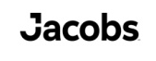


Architectural Design as a Determinant of Health
Diana Anderson, MD, M.Arch, FACHA
Assistant Professor of Neurology, Boston University
Co-Founder, MGB Health Design Lab
Healthcare Principal, Jacobs
@dochitect www.dochitect.com diana.anderson@dochitect.com

Slide 2
Funding Sources:
Alzheimer’s Association Clinician Scientist Fellowship
Mass General Brigham – Health Design Lab
@dochitect www.dochitect.com diana.anderson@dochitect.com

Slide 3

The buildings
we spend time in change us –
our minds, our behaviors and our health.
Image Credit: Diana Anderson
Notes:
Give anecdote about

Slide 4
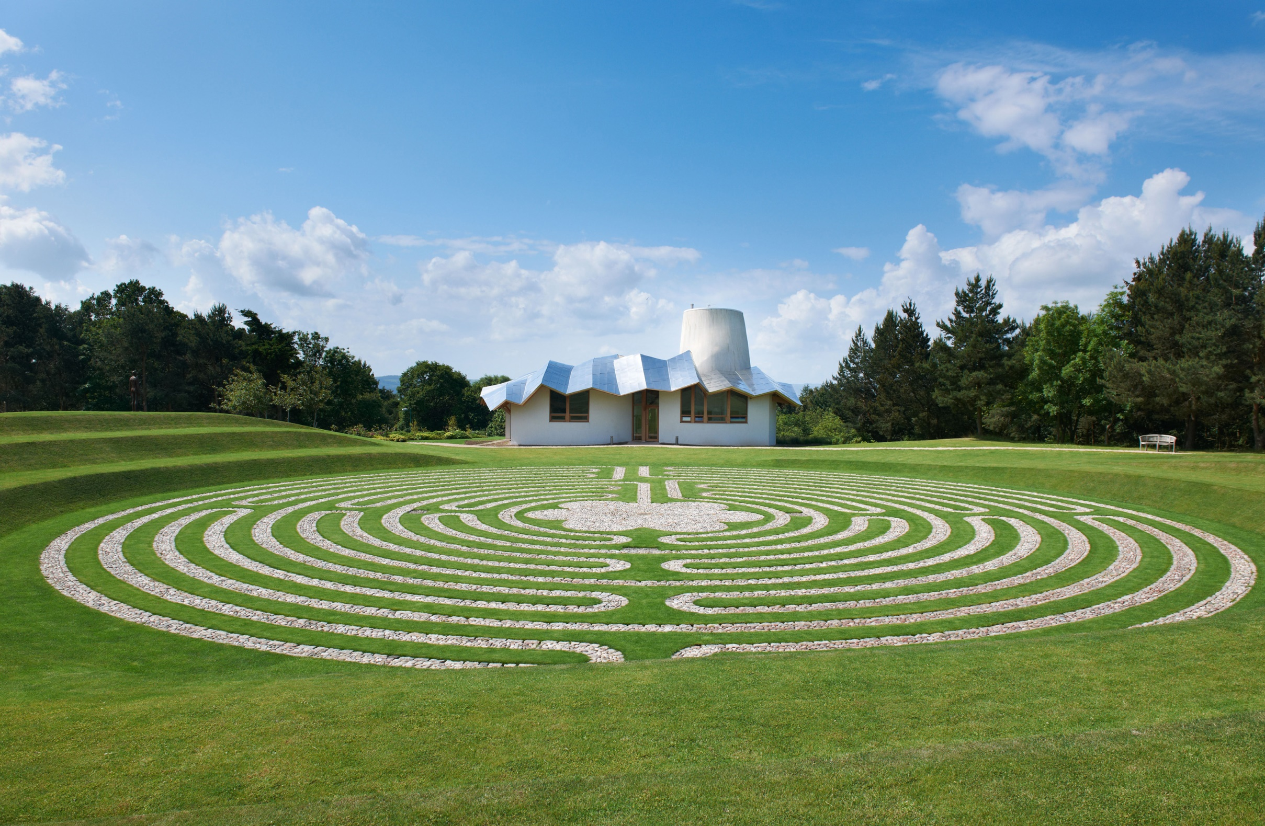
Maggie's Dundee Ninewells Hospital
Dundee United Kingdom
Gehry Partners, LL
Notes:
The innovative model of psychosocial oncology care is seen in the Maggie’s Centres in the UK and Hong Kong. Leading architects have focused on the notion that cancer treatment can be drastically improved through good design. Charles Jencks’, Maggie’s husband makes a powerful statement that “architecture may even help prolong life and affect outcomes.”
What if I told you now that I could impact how long you might stay in the hospital and how much pain medication you might take. And no, I am not speaking as your doctor. I am speaking as your architect. How can I do that?

Slide 5


23 surgical patients in rooms looking at a natural scene:
Shorter hospital stays
[T(17) = 35, z = 1.965, p = 0.025]
Received fewer negative
comments in nurses' notes
[T(21) = 15, z = 3.49, p < 0.001]
Took fewer potent analgesics [T²=13.52, F = 4.30, p < 0.01]
vs 23 matched patients in similar
rooms facing a brick wall.
Photo Credit: Diana C. Anderson
Ulrich RS. View through a window may influence recovery from surgery. Science. 1984;224(4647):420-421. doi:10.1126/science.6143402
Notes:
it’s becoming evident that the way spaces are designed has a measurable impact.

Slide 6
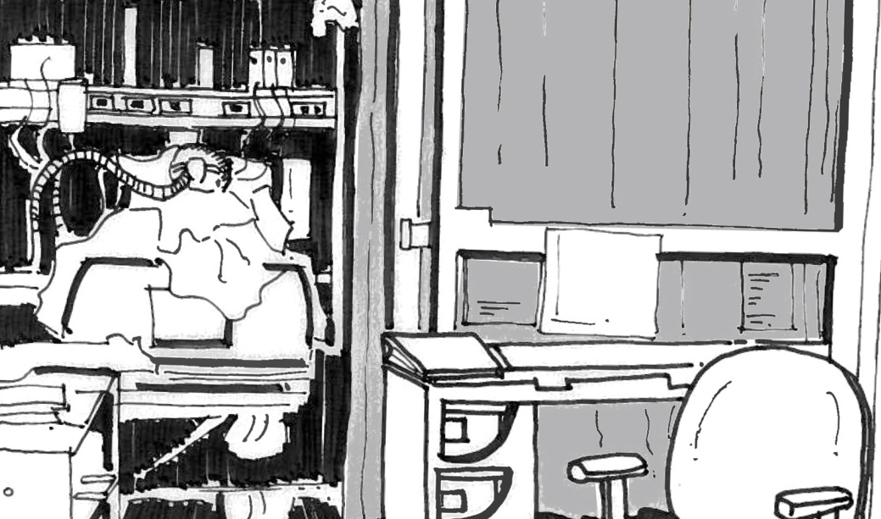
Sketch by: Diana Anderson
Notes:
What if architecture was treated as a vital part of wellness, of active treatment & prevention?
Story Miss T

Slide 7
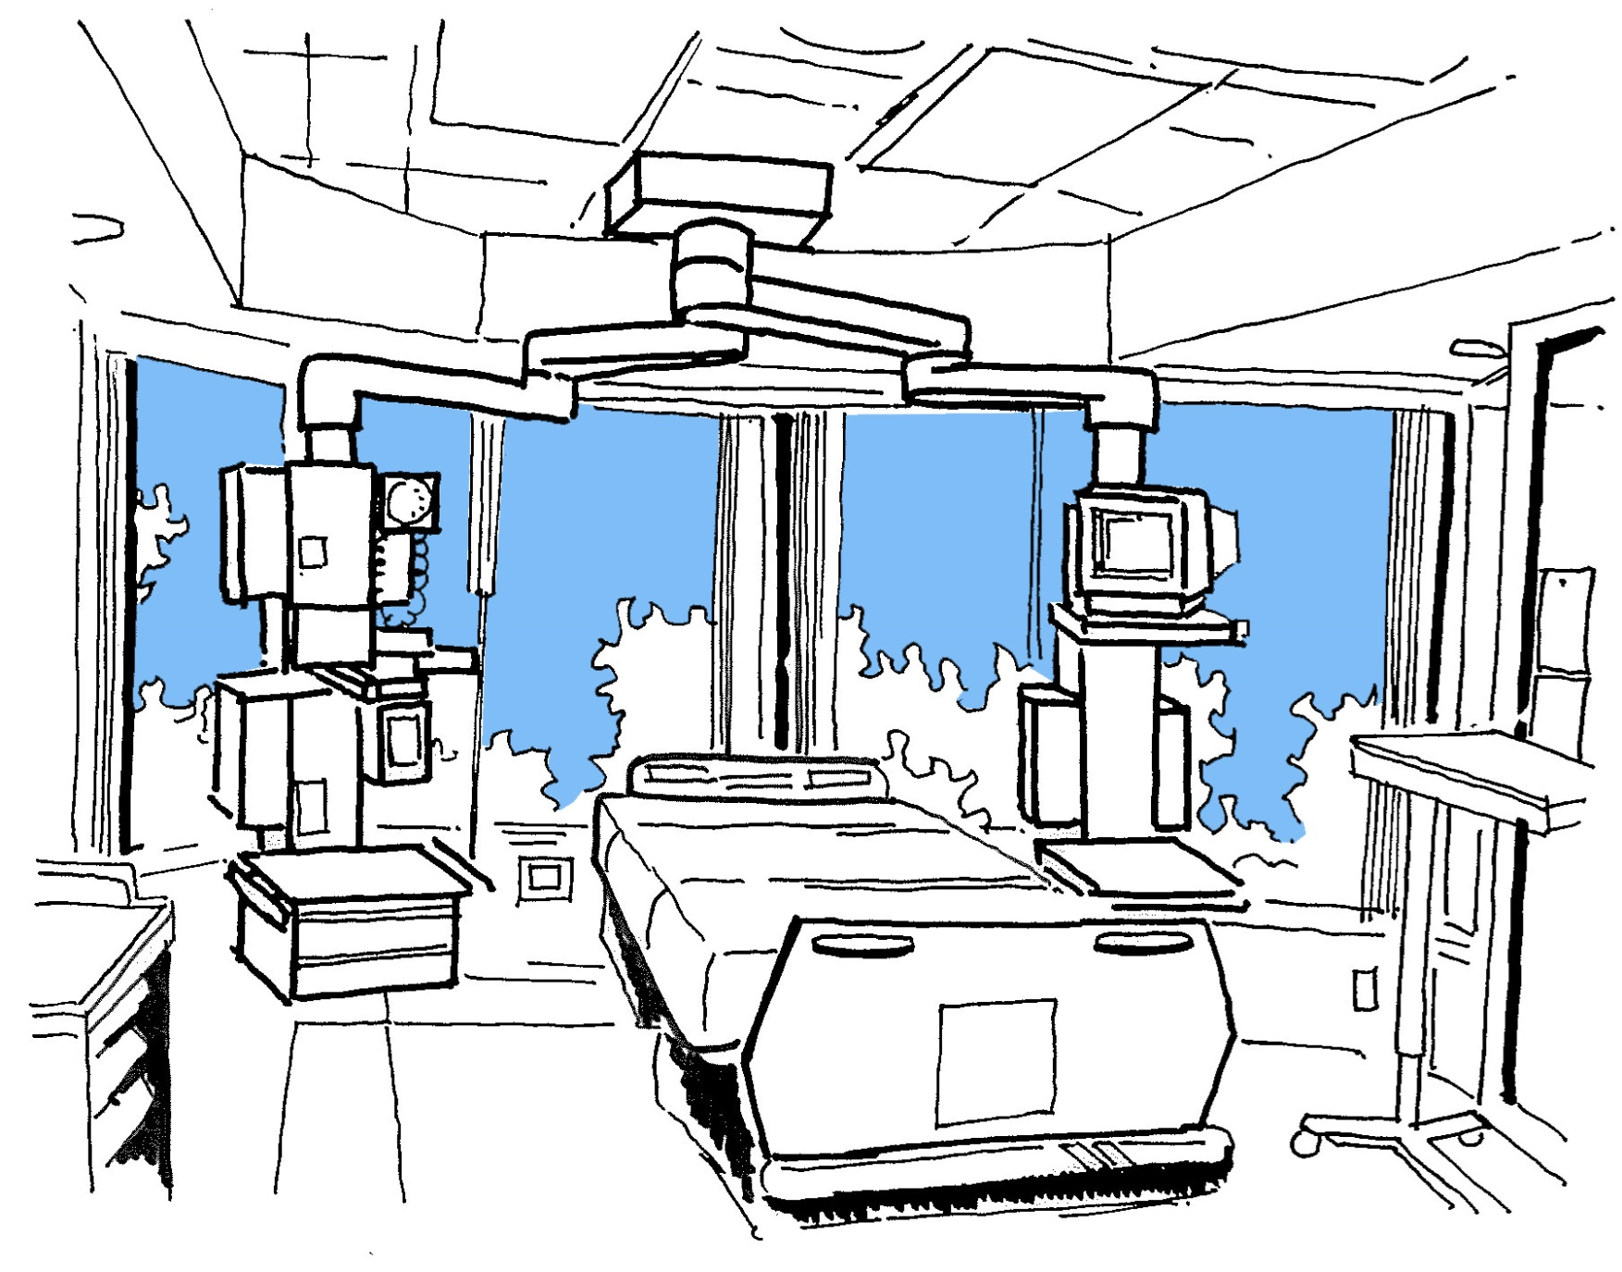
Sketch by: Diana Anderson
Notes:
For some patients, where drugs might fail in cure, design can succeed in care.
Dr. Denis Burkitt said that: “Disease can rarely be eliminated through early diagnosis or good treatment, but prevention can eliminate disease.” Delirium or acute brain failure is one area where design plays a preventative role. The classic presentation is an ICU patient becoming confused, perhaps hallucinating. It is hard to treat and can take a long time to resolve with serious consequences, including increased cognitive impairment. All of this has a cost in both dollars and quality of life. Delirium lacks pharmacologic treatments- it is best to prevent it. The NEJM provides a prevention algorithm- by providing reorientation, normalizing sleep wake cycles, and family presence can often prevent delirium. All of these elements can be addressed through room and hospital design.
Although we didn’t know for sure if the room change was the cause of her clinical improvement, from that day on we kept ‘window bed’ on our patient care plans. Although only an anecdote this can lead to confirmation studies and change follows. Design can prevent illness. Design matters.

Slide 8
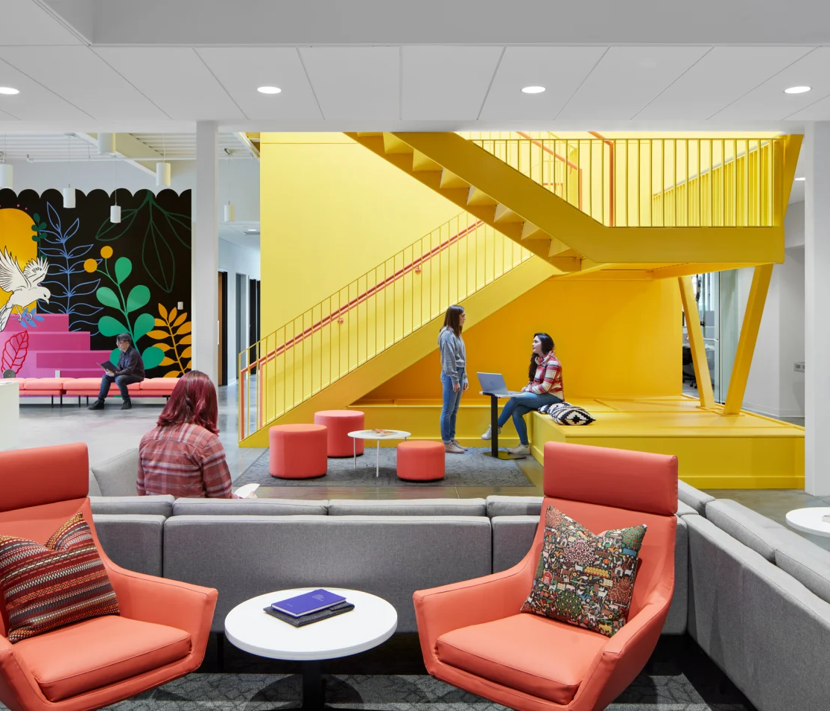
Design for Health
The built environment is a parameter of care and must be considered alongside the others.
Project: Family Tree Clinic, Minneapolis MN; Perkins&Will
Anderson, D., Teti, S, Hercules, W., Deemer D. The Bioethics of Built Space: Health Care Architecture as a Medical Intervention. Hastings Center Report, Weblink, 27 Apr 2022. Accessed 2 Aug 2023.
Notes:
Our understanding of the role the environment plays in shaping us and our interactions has expanded immensely. Researchers have examined the profound effect social and environmental factors can have on behavior and decision-making.
Yet, design choices in the built healthcare environment raise substantive bioethical issues that demand the attention of bioethicists and ethical inquiry.

Slide 9

Environmental Factors
Affecting Outcomes
Form
Unit layout
Floor material
Room features
Medical equip visibility
Nature
Lighting
Music
Jamshidi S, et al. The effects of environmental factors on the patient outcomes in hospital environments. Frontiers of Architectural Research. 2020 June; 9(2):249-263.
Project: Allegheny Health Network Wexford Hospital, Wexford PA; HKS

Slide 10

Ethical Issues in Healthcare Design
Akin to medicine, healthcare architecture can benefit from a bioethics lens.
Some firms involve frontline healthcare professionals in design decisions, but this is not required.
No regulatory structure exists to consider the kinds of issues raised here.
Project: Seattle Children's Building Care: Diagnostic and Treatment Facility, Seattle WA; ZGF Architects

Slide 11
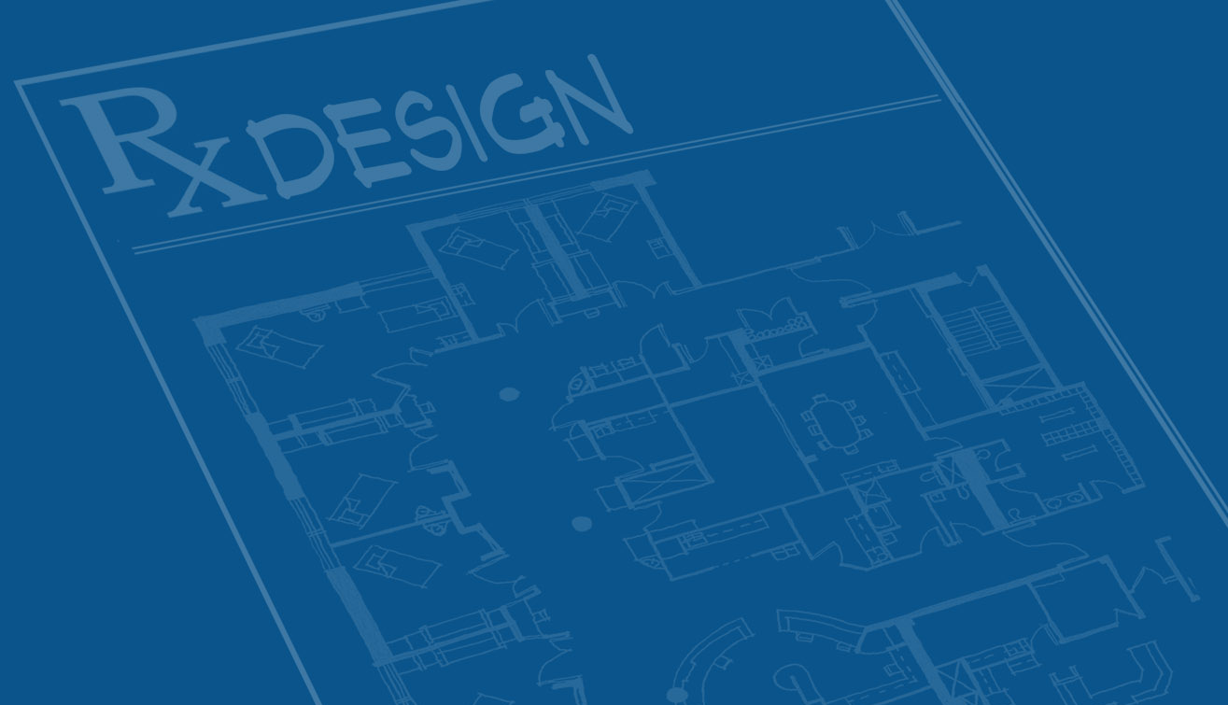
What is our moral imperative to ensure the healthcare buildings we design & build do no harm?
Notes:
EBD is primarily focused on patient outcomes, and began that way. Everywhere you see the headlines “putting patients first”, “transforming the patient experience”. But whose voice should be prioritised when funding and designing hospitals and health services? In other words, who are we designing hospitals for­­- the clinicians, the patients and their families, the administrators?
By “our” I don’t mean only the architects but also the policy makers, administrators etc

Slide 12
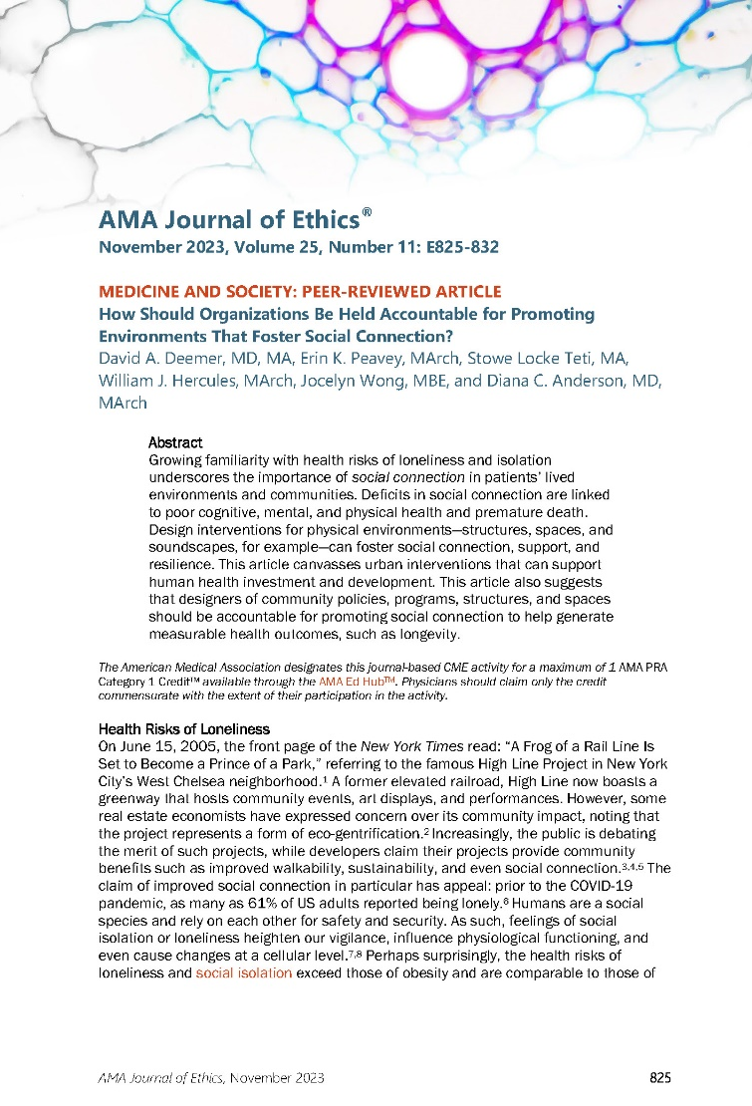
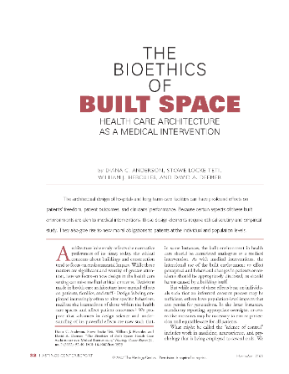
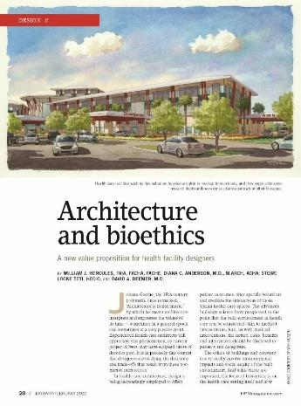
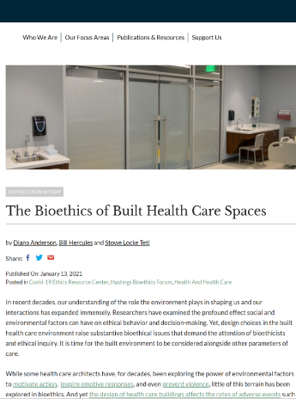

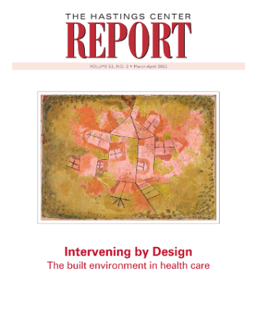
Anderson, D. Hercules, W., Teti, S, The Bioethics of Built Health Care Spaces. Hastings Center Bioethics Forum Essay, Weblink, 13 Jan 2021. Accessed 2 Aug 2023.
Hercules W, Anderson D, Teti S, Deemer D. Architecture and bioethics. Health Facilities Management Magazine. Weblink. 5 Feb 2022. Accessed 2 Aug 2023.
Anderson, D., Teti, S, Hercules, W., Deemer D. The Bioethics of Built Space: Health Care Architecture as a Medical Intervention. Hastings Center Report, 27 Apr 2022.
Deemer, D; Teti, S; Hercules, W; Peavey, E…Anderson, D. "How Should Organizations Be Held Accountable for Promoting Environments That Foster Social Connection?". American Medical Association Journal of Ethics. 2023;25(11):E825-832. doi: 10.1001/amajethics.2023.825. Online. 1 Nov 2023.

Slide 13

Ethical Issues in Health Design:
Two Types
Incidental
Nursing home deaths
Hand-washing
ICU room placement
Maternity unit design
Chair placement
Bed design
Notes:
New knowledge can engender new responsibilities

Slide 14
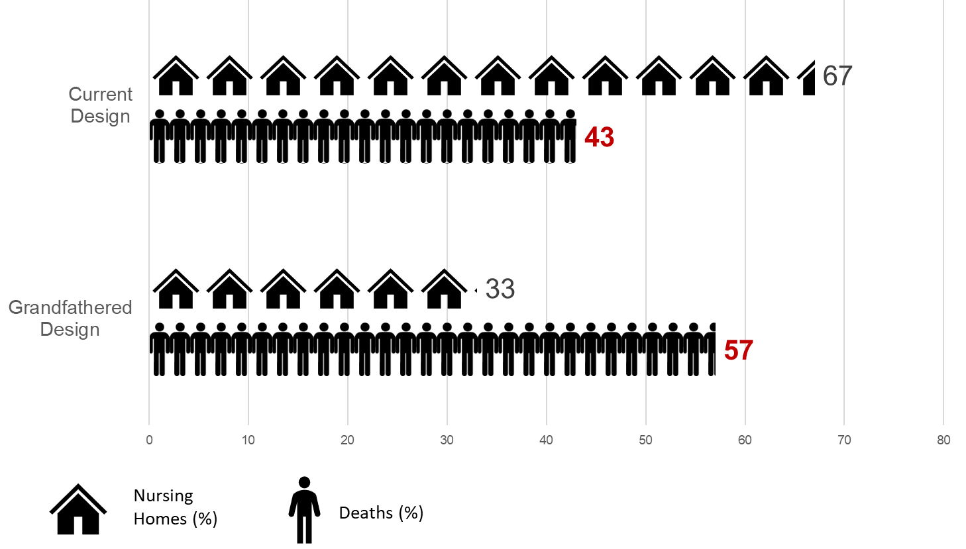
The Deadly Cost of Delay
Living in a Canadian nursing home grandfathered into the 1972 design standard nearly doubled the risk of death due to COVID-19
Pedersen K, Mancini M, Wolfe-Wylie W. Ont. nursing homes have had 22 years to do safety upgrades. COVID-19 reveals deadly cost of delay. CBC. June 9, 2020. Weblink. Accessed 10/12/21.
Notes:
Covid19 and LTC: Differential Impact of COVID-19

Slide 15
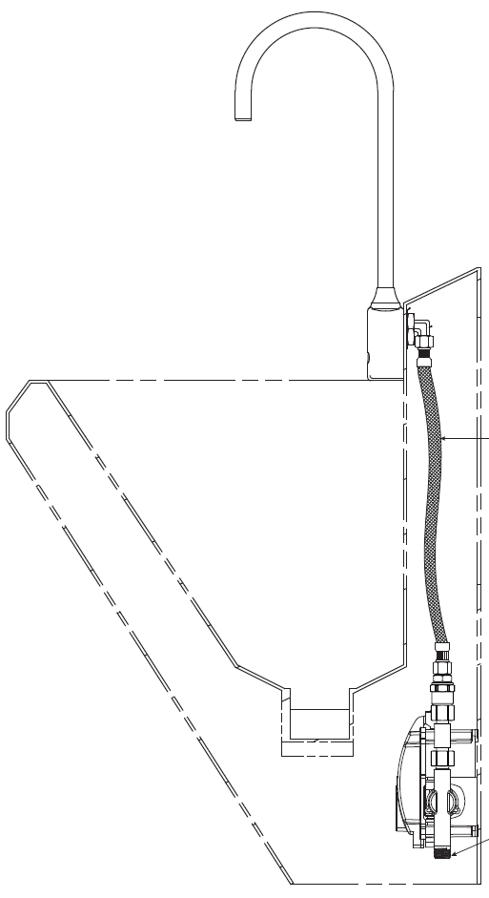
Sink Availability
Independent Predictor of Handwashing Compliance
Every additional meter that must be walked by the healthcare worker to reach a sink decreased the likelihood of hand washing by approximately 10%.
Deyneko, A., Cordeiro, F., Berlin, L. et al. Impact of sink location on hand hygiene compliance after care of patients with Clostridium difficile infection: a cross sectional study. BMC Infect Dis 16, 203 (2016).

Slide 16
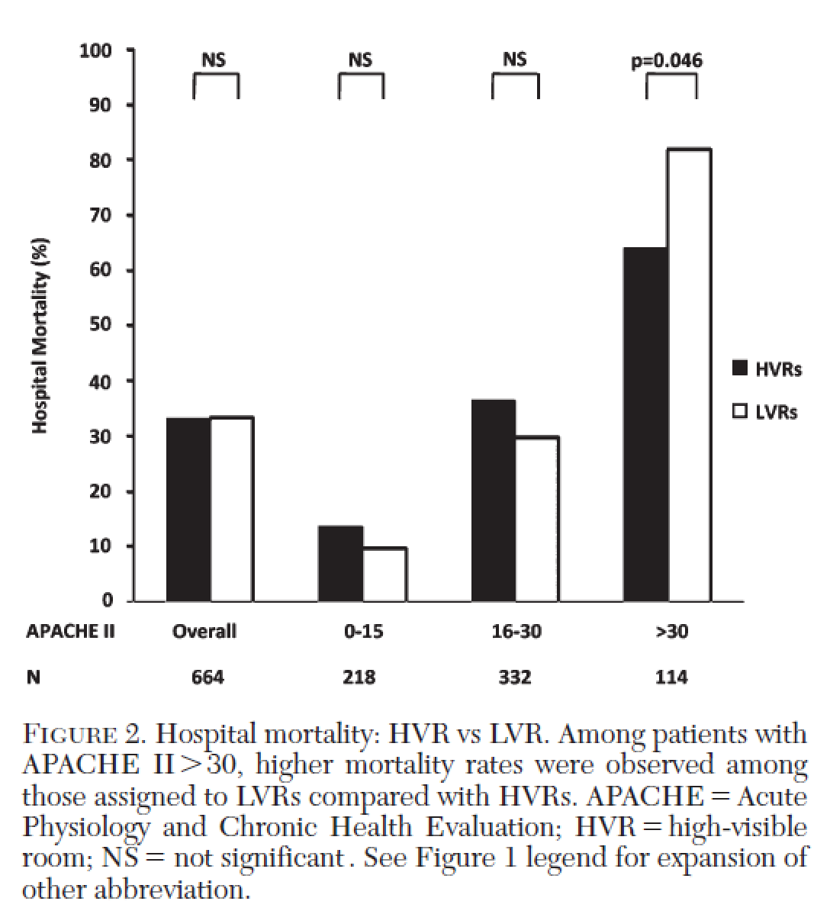
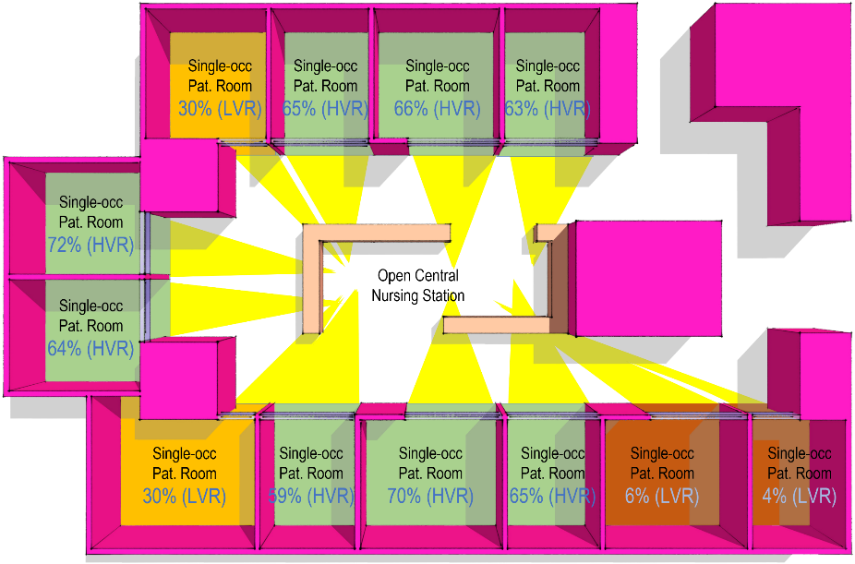
Design Equity
Severely ill patients had significantly higher hospital mortality when admitted to an LVR than did those admitted to an HVR (82.1% and 64.0%, n 539 and 75, respectively; p =.046).
ICU mortality a similar pattern. ICU LoS and ventilator-free days did not differ significantly between groups.
Leaf DE, Homel P, Factor PH. Relationship between ICU design and mortality. Chest. 2010 May;137(5):1022-1027. doi: 10.1378/chest.09-1458.
Lu Y, Ossman, MM, Leaf D, Factor PH. Patient Visibility and ICU Mortality: A Conceptual Replication. Health Environments Research and Design. Volume: 7 issue: 2, page(s): 92-103.
Notes:
Providing the same level of care to all patients is presumed in hospitals, but the built environment may preclude that in subtle ways. One study of 664 patients found severely ill patients may experience higher mortality rates when placed in intensive care unit rooms that are out of direct lines of sight of nursing staff and physicians.

Slide 17
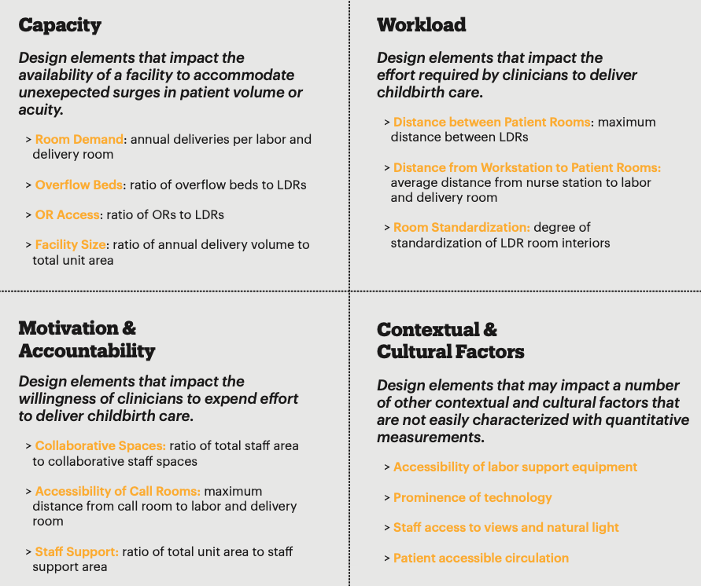
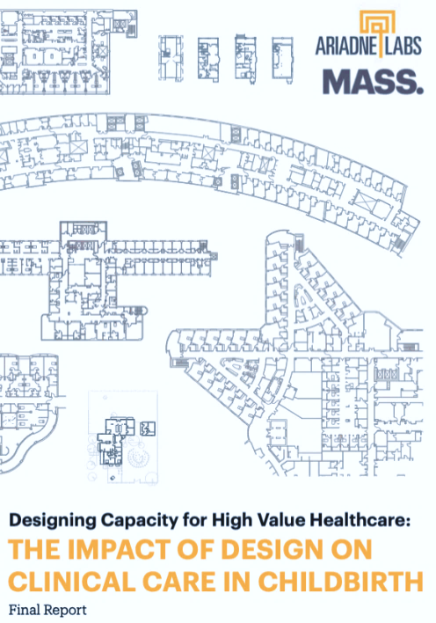
Does Healthcare Design Influence Rate of C-sections?
MASSDesign & Ariadne Labs. Mixed-methods, descriptive analysis of the design of 12 childbirth facilities across the US.
Floor plan analysis, site visits, interviews, facility profiles. Identified evidence-supported design elements that may impact processes and outcomes of childbirth.
D
Shah N, Galvin G, Plough A, et al. “Designing Capacity for High Value Healthcare: The Impact of Design on Clinical Care in Childbirth”. Ariadne Labs / Mass Design, Maternal Health Task Force at the
Harvard Chan School. April 2017. https://www.mhtf.org/document/designing-capacity-for-high-value-healthcare-the-impact-of-design-on-clinical-care-in-childbirth/. Accessed 20 Nov 2023.
Notes:
Consider the following examples. It is common today for disagreements to occur around myriad aspects of maternal care in hospitals: refusals to wear fetal monitoring for fear of higher risk of C-sections is common, with unnecessary C-sections increasingly common.¹⁸ This can lead to conflicts that result in disruption of services, poor patient experiences, and an unpleasant work environment. The healthcare architect on the project could direct our group of stakeholders to Ariadne Labs’ research into the causes of unnecessary C-sections. Ariadne Labs found rates of C-sections could be partly explained by the physical layout and space design of birth facilities. The study authors posited unnecessary C-sections could be reduced with design interventions that lessen throughput pressure in birth facilities.¹⁹ For example, allocating relatively greater space to natural birth areas than operating areas. Through this evidence-based approach, the facility design could incorporate the pressure tank model Ariadne Labs identified and put in place steps to mitigate pressure to move patients to C-sections apart from medical need.

Slide 18
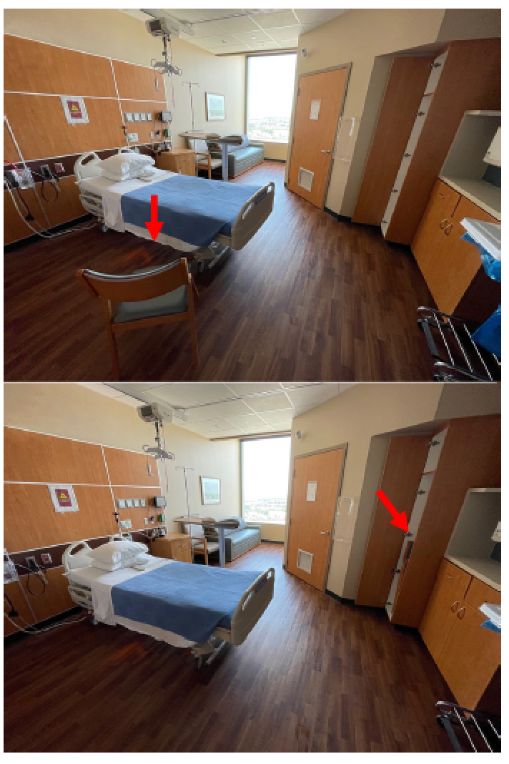
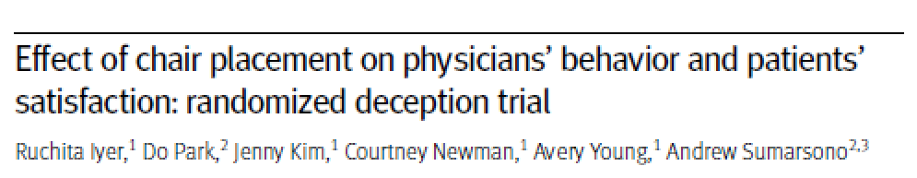
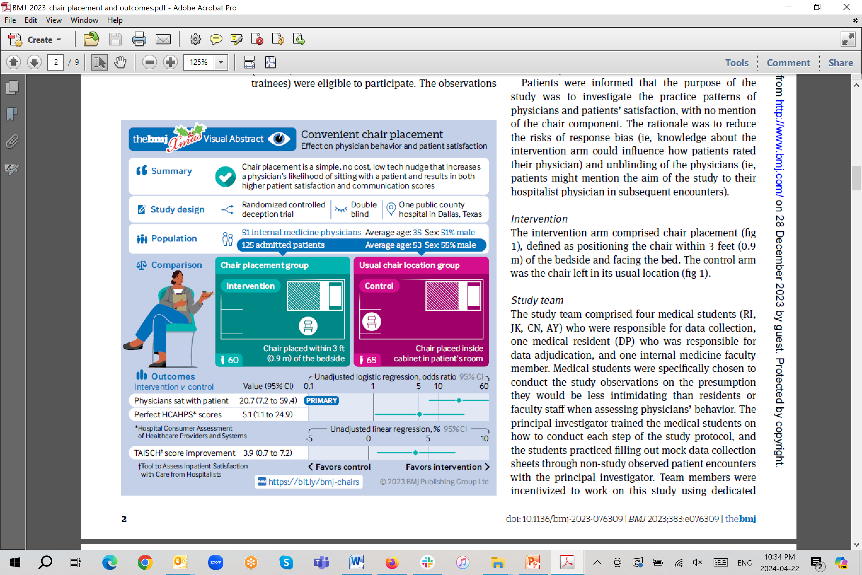
Choice Architecture
38 of 60 physicians in chair placement group sat during the encounter vs. 5 of the 65 in the control group (OR 20.7, 95% confidence interval 7.2 to 59.4; P<0.001).
Chair placement increases a physician’s likelihood of sitting during a bedside consultation; resulted in higher patient scores for both satisfaction and communication.
Iyer R, Park D, Kim J, Newman C, Young A, Sumarsono A. Effect of chair placement on physicians' behavior and patients' satisfaction: randomized deception trial. BMJ. 2023;383:e076309.
Notes:
Outcomes: decision to sit or not sit during a patient encounter, patient satisfaction.

Slide 19
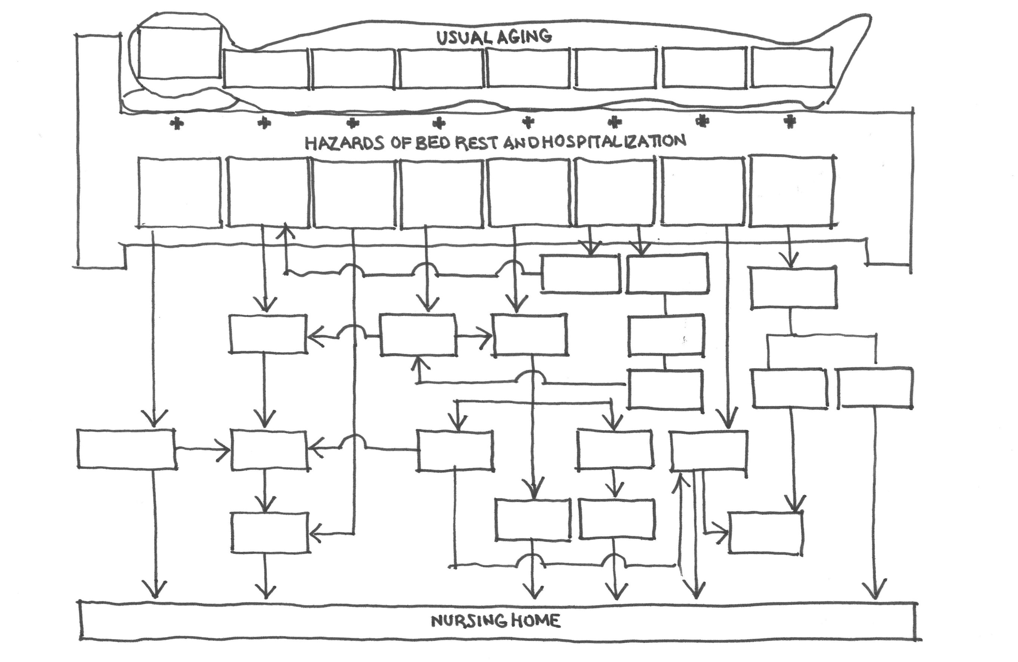
Cascade to Dependency
Muscle Strength
Vasomotor
Instability
Bone
Density
Sensory
Continence
Altered Thirst
& Nutrition
Fragile
Skin
Tendency to Incontinence
Ventilation
Immobilization - High Bed Rails
Plasma Volume
Accelerated Bone Loss
Closing
Volume
Sensory
Depravation
Glasses or Hearing Aid
Barriers
“Tether”
Rx Diet
Immobilization Shearing
Force
Barriers Tethers
Dehydration
Malnutrition
Functional
Incontinence
Syncope
pO₂
Delirium
Tube
Aspiration
Catheter
Family
Rejection
Deconditioning
Fall
Physical
Restraint
Chemical
Restraint
Pressure
Sore
False
Label
Tardive
Dyskinesia
Fracture
Infection
NURSING HOME
Creditor MC. Hazards of hospitalization of the elderly. Ann Intern Med. 1993;118(3):219-223.
Creditor M. Hazards of Hospitalization of the Elderly. Annals of Internal Medicine, 1993;118(3):219-223.

Slide 20
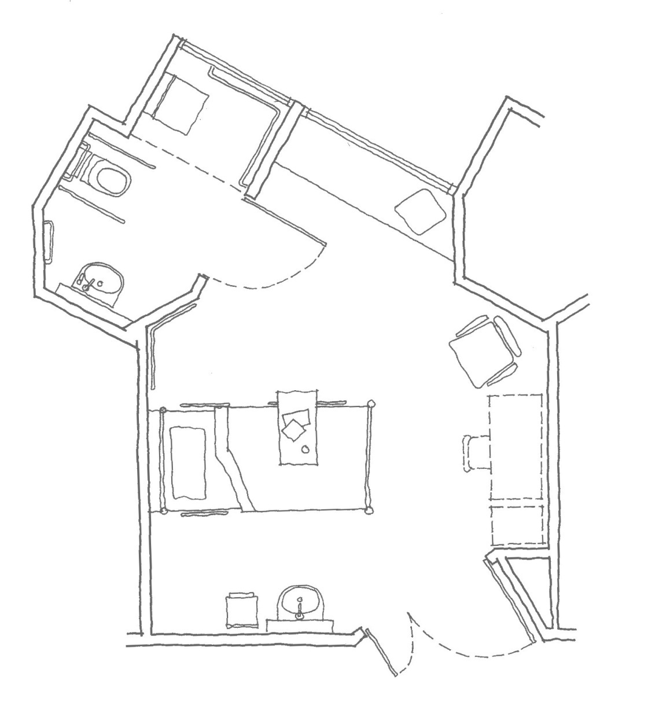
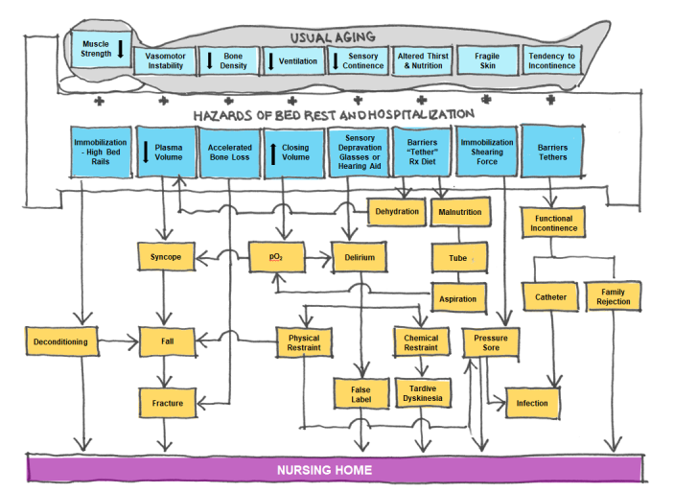
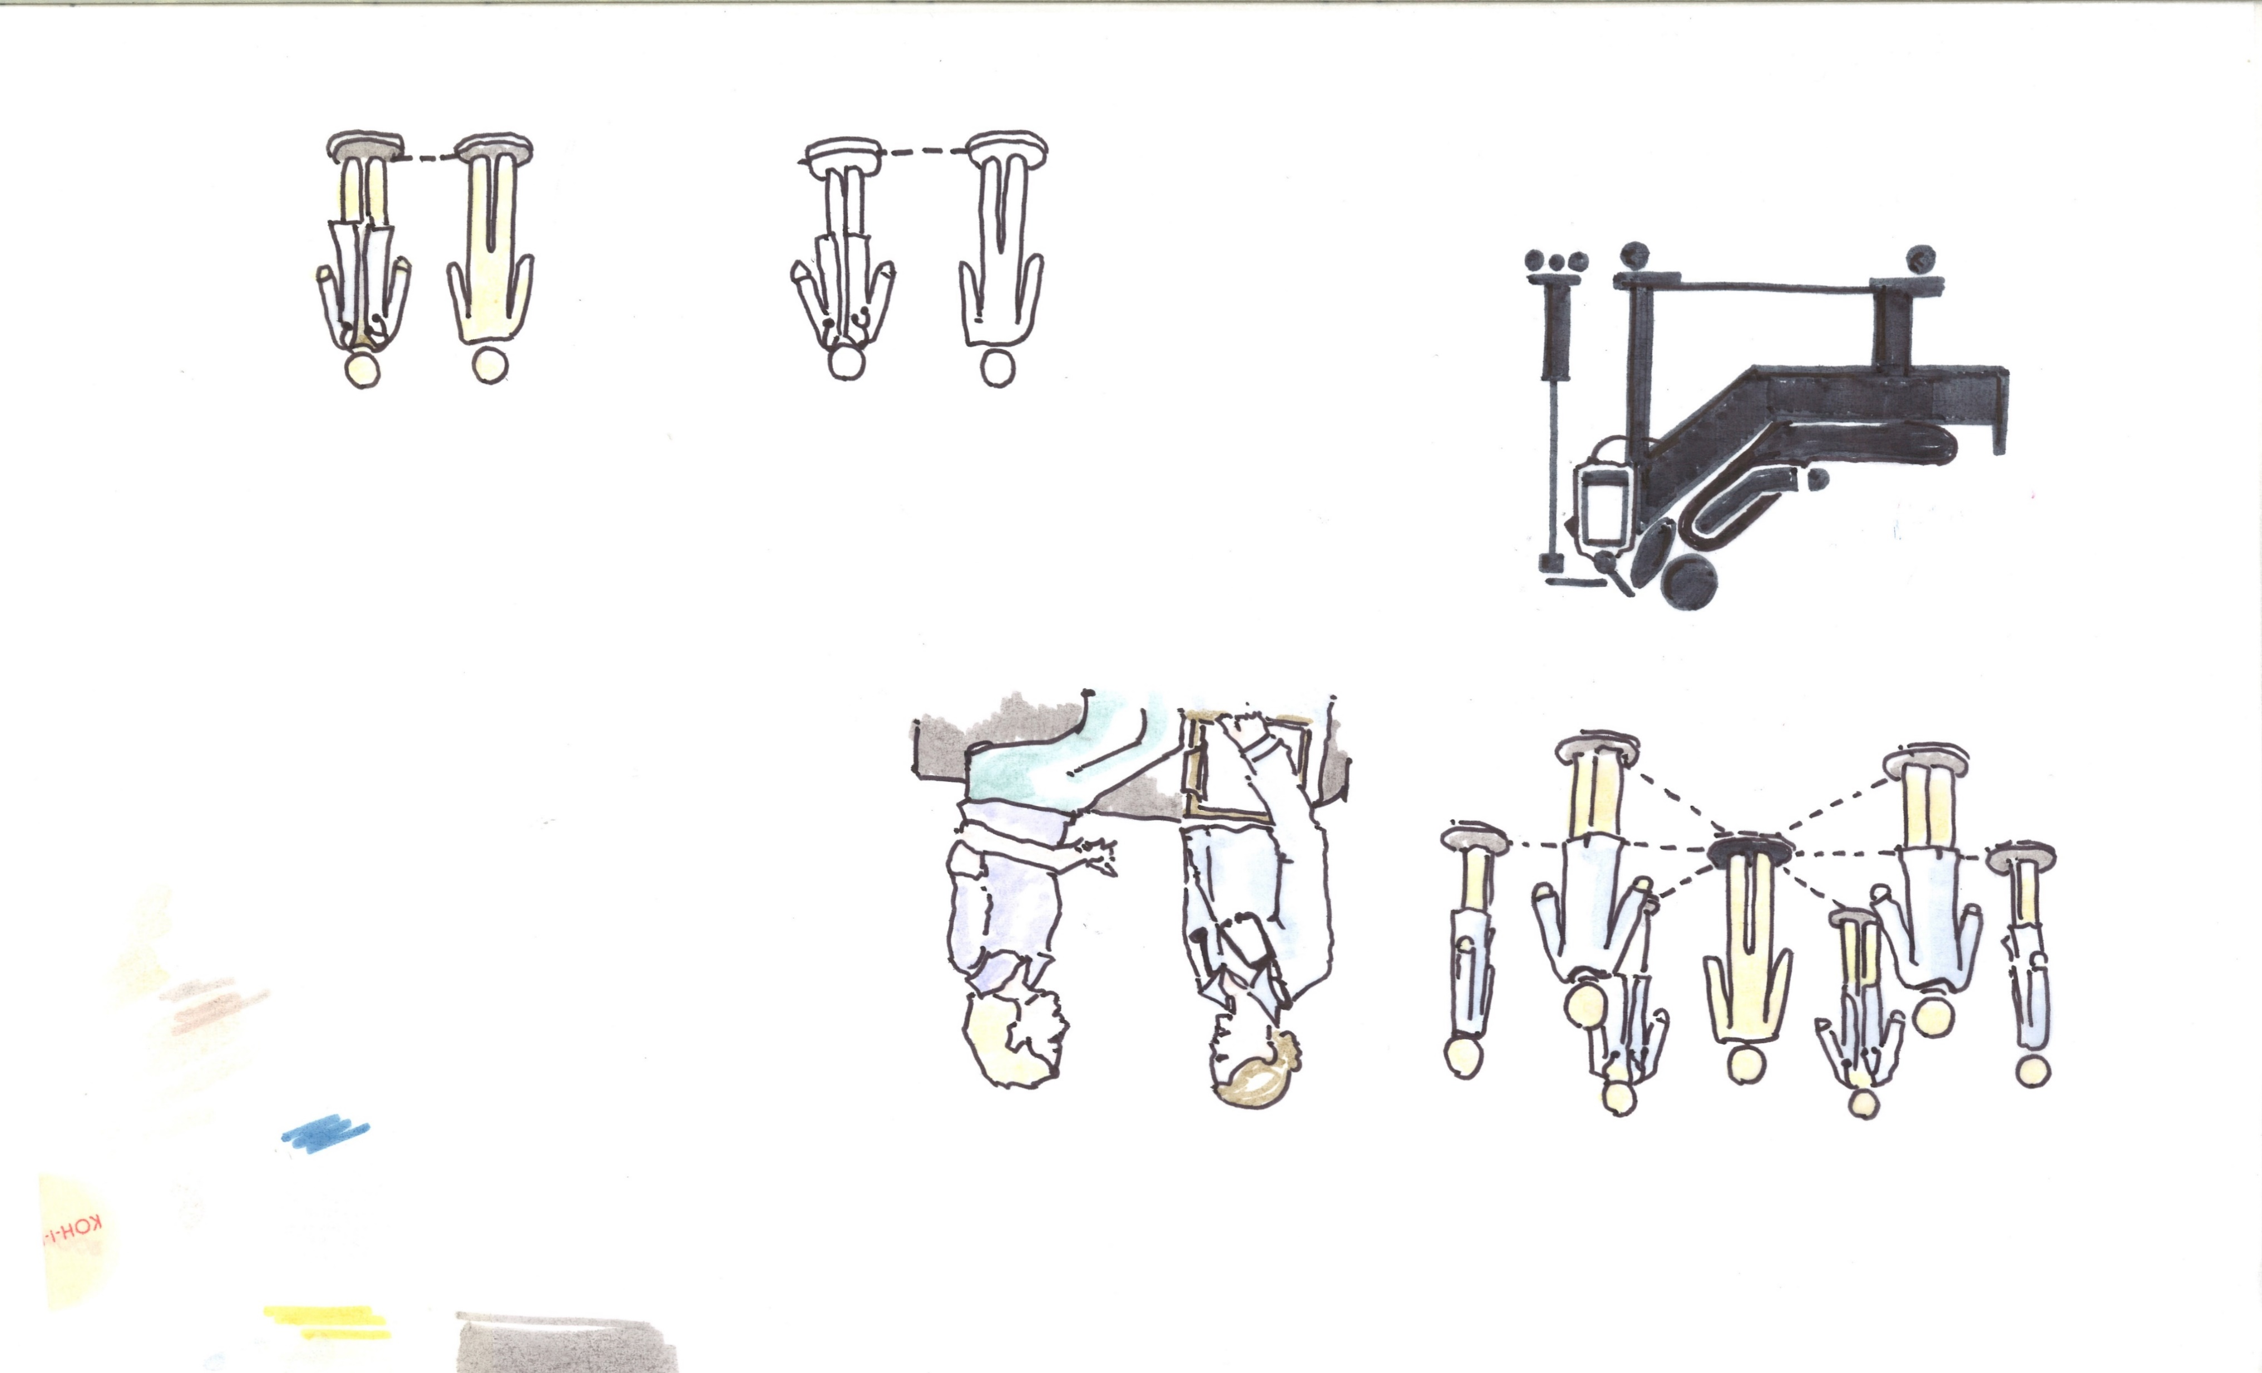
Confinement by Design
“I know of no evidence that shows the therapeutic value of bed rest.”
– Morton Creditor, MD
Creditor MC. Hazards of hospitalization of the elderly. Ann Intern Med. 1993;118(3):219-223.

Slide 21

Deliberate Efforts to Alter Behavior and Exert Control
with the Built Environment
Ethical Issues in Health Design:
Two Types
Deliberate
Floor patterns
Villages and immersive LTC settings
Light bulbs in LTC
Tableware color
Notes:
Stowe

Slide 22
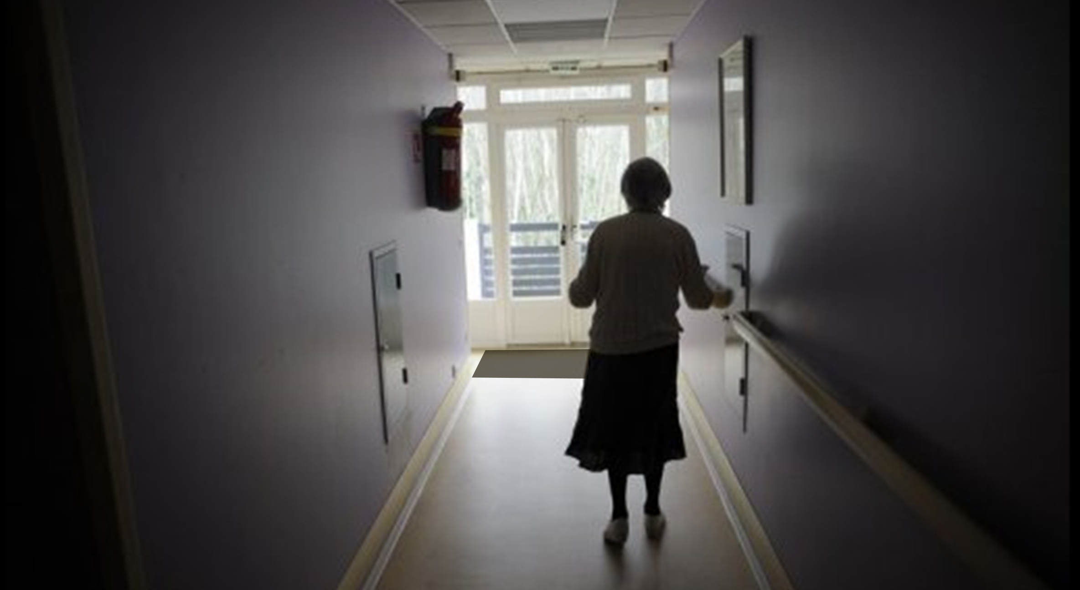

Slide 23
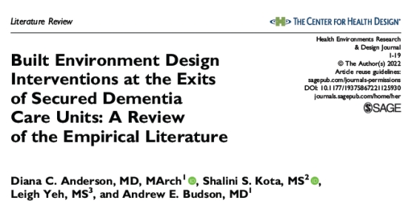
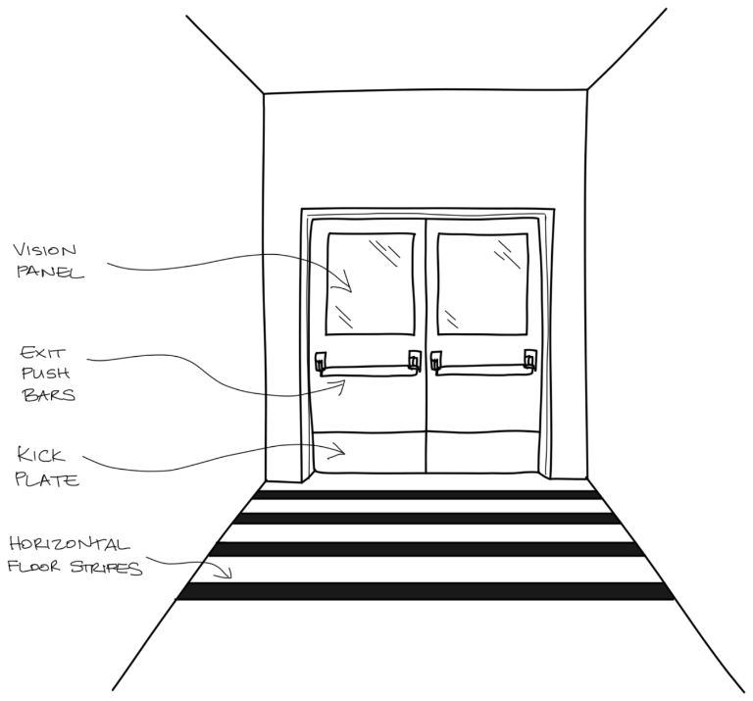
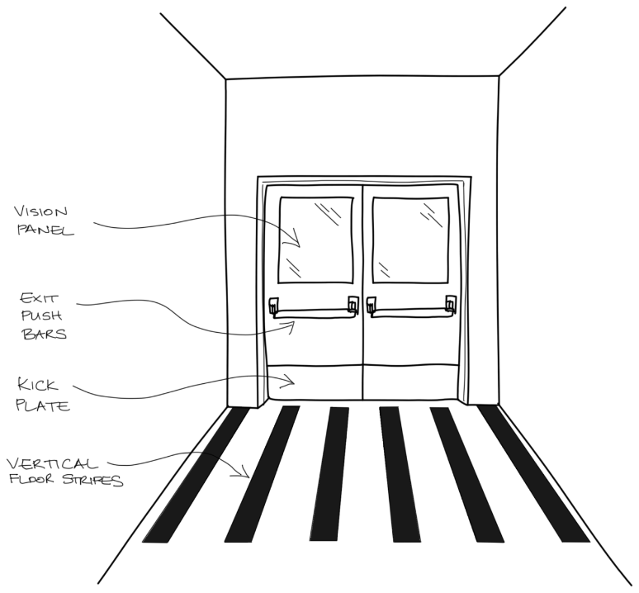
Floor Patterns to Control Egress
Exiting attempts decreased from 98% at baseline to 42% with the addition of horizontal floor tape
Vertical striping was less effective than the horizontal pattern
Hewawasam, L. (1996). Floor patterns limit wandering of people with Alzheimer's. Nurs Times, 92(22), 41-44.
Hussian, R. A., & Brown, D. C. (1987). Use of two-dimensional grid patterns to limit hazardous ambulation in demented patients. J Gerontol, 42(5), 558-560.
Notes:
“Walking with purpose,” formerly “wandering”- common behavioral symptom of dementia - frequent walking and attempts to exit a space.
Methods of preventing or limiting walking with purpose: alarms, locking doors, physical or chemical restraint.
Recent dementia care unit design trends - shift toward supporting autonomy; easily navigable spaces to reduce or promote walking with purpose.
An overall paucity of intervention studies.
Horizontal and vertical floor grid patterns
Mirror placement
Painting murals
Disguising door hardware or windows
Conditioning responses to color cues
Exit attempts decreased Exit attempts decreased from 98% at baseline with no intervention, to 42% with the addition of horizontal grids
Follow-up study horizontal floor grid reduced exit door contact by up to 97% for those with AD; less effective in other dementias
No intervention effect w/ glass doors; attractive outdoor views -> overcome aversion to optical illusion
Black floor mats -> anecdotal
Why do these interventions work/not work?
Floor patterns
diminished visual perceptual abilities in dementia: contrast sensitivity, color discrimination, and depth perception
posterior cortical atrophy (PCA), visual variant of AD: deficits in visual perception, spatial awareness, 3D shape processing
visual misperceptions of 2D stimuli → appear 3D
Camouflage/cover
AD or DLB (even without PCA) frequently show impairments in visual acuity, color perception, and texture recognition
success of cloth cover regardless of color or pattern
Mirror
difficulty identifying reflected self images
Mural/arts-based interventions
provision of diversion and camouflage for door hardware
Conditioning
deficits in episodic memory common in ADRD (memories of personal experiences)
automatic, unconscious use of procedural memory is separate and distinct and can be spared
stimulus control methodology successful -> implicit memory preserved
XXXXXXXXXXXX
Concealment: beige cloth hiding doorknob:
most successful intervention, eliminated all exiting
color and pattern of cloth did not matter!
Camouflage: doorknob painted door color, doorknob cover
less successful than concealment
more effective than the use of grid tape patterns
Mini-blinds: covering windows to match door color
only marginally significant in reducing exiting attempts
Combined use: blind and cloth barrier
more effective than blind alone; not as effective as just cloth covering

Slide 24
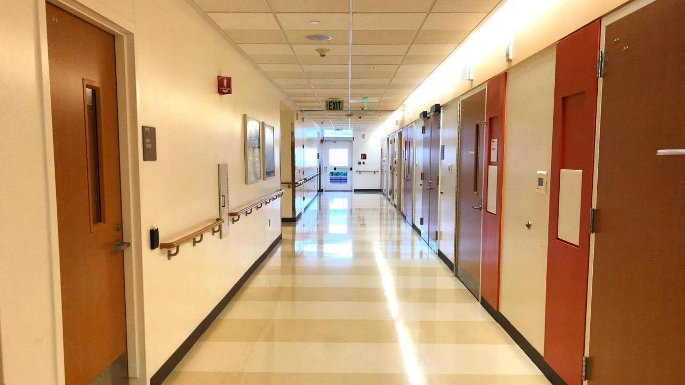
Photo Credit: Diana Anderson
Notes:
Responsibility to use existing research and knowledge when designing

Slide 25

Fall Reduction and Lighting in Nursing Homes
2 care homes, n=758
Solid-state lighting: intensity & spectrum changes to increase short-wavelength (blue light) during the day and decrease it overnight.
Control sites: no change in intensity or spectrum.
Falls reduced by 43% at experimental sites (4.82 vs 8.44 falls per 1000 resident-days, respectively; RR 0.57; 95% CI 0.39-0.84; p=.004).
Image Credit: The Lighting Practice. “What is Circadian Lighting?”: https://www.thelightingpractice.com/what-is-circadian-lighting/. Accessed 20 Nov 2023.
Grant, Leilah; St. Hilaire, Milissa; Heller, Jenna; Heller, Rodney; Lockley, Steven; Rahman, Shadab. “Impact of Upgraded Lighting on Falls in Care Home Residents” . JAMDA: Journal of Post-Acute and Long-term Care Medicine. Vol 23, Is 10, P1698-1704, E2. October 2022. https://www.jamda.com/article/S1525-8610(22)00471-6/fulltext. Accessed 20 Nov 2023.
Notes:
Two care homes, n=758
Solid-state lighting: changed in intensity & spectrum to increase short-wavelength (blue light) during the day and decrease it overnight.
Control sites retained standard lighting: no change in intensity or spectrum throughout the day.
Falls reduced by 43% at experimental sites vs control sites (4.82 vs 8.44 falls per 1000 resident-days, respectively; RR 0.57; 95% CI 0.39-0.84; P = .004).

Slide 26

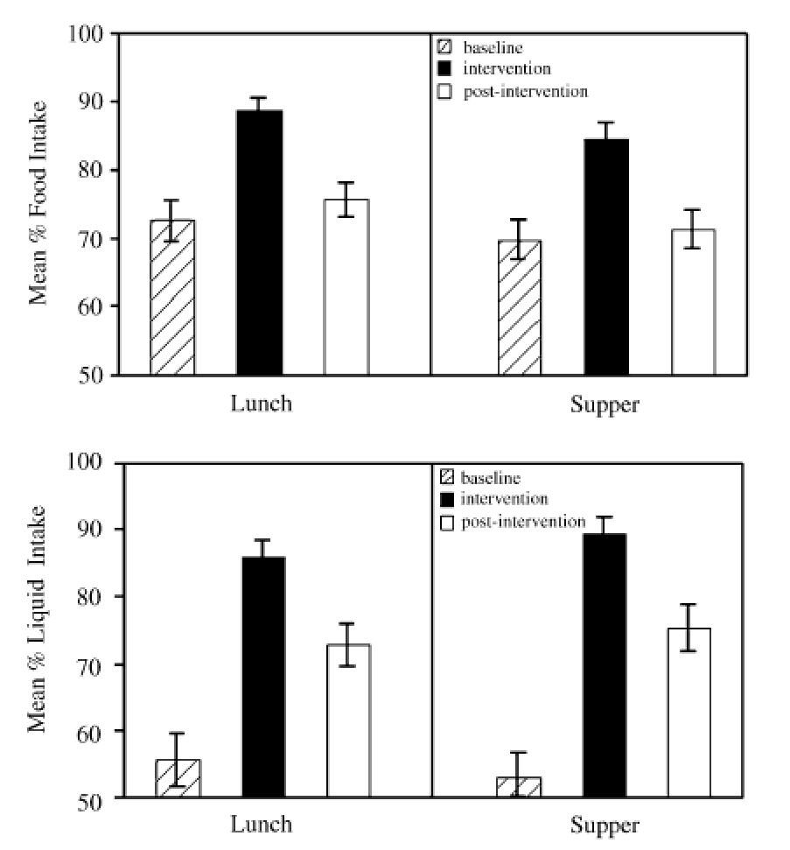
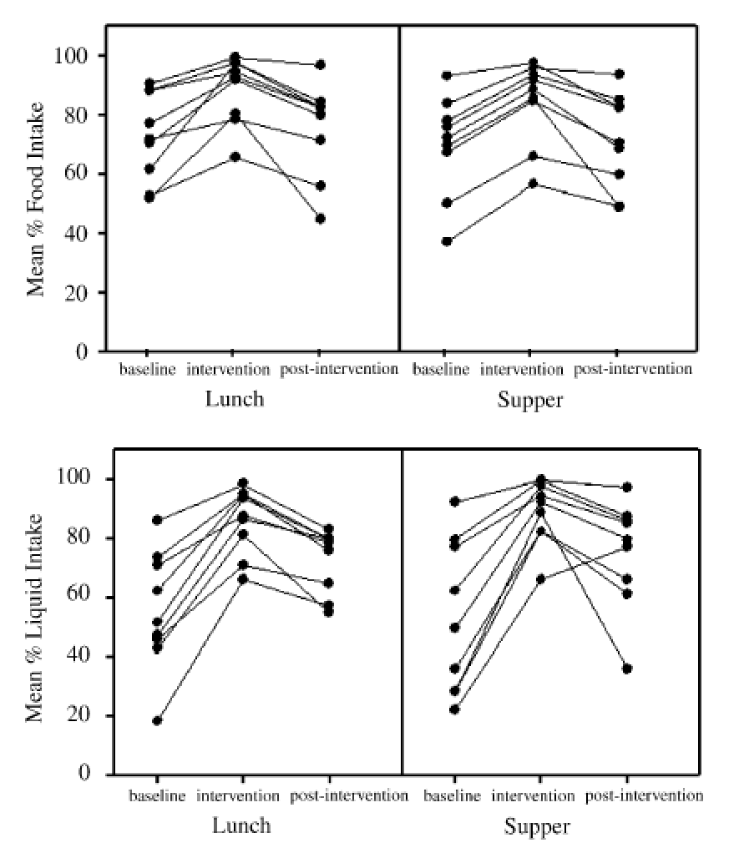
Non-Pharmacologic Treatment Modalities
White tableware vs high contrast red tableware
Mean increase was 25% for food and 84% for liquid for the red tableware
8 of 9 participants exhibited increased intake
Dunne TE, Neargarder SA, Cipolloni PB, Cronin-Golomb A. Visual contrast enhances food and liquid intake in advanced Alzheimer's disease. Clin Nutr. 2004 Aug;23(4):533-8.

Slide 27

Balancing Evidence and Experience
?
Health Infrastructure
Evidence-Based
Practice
Expertise-Based
Practice

Slide 28
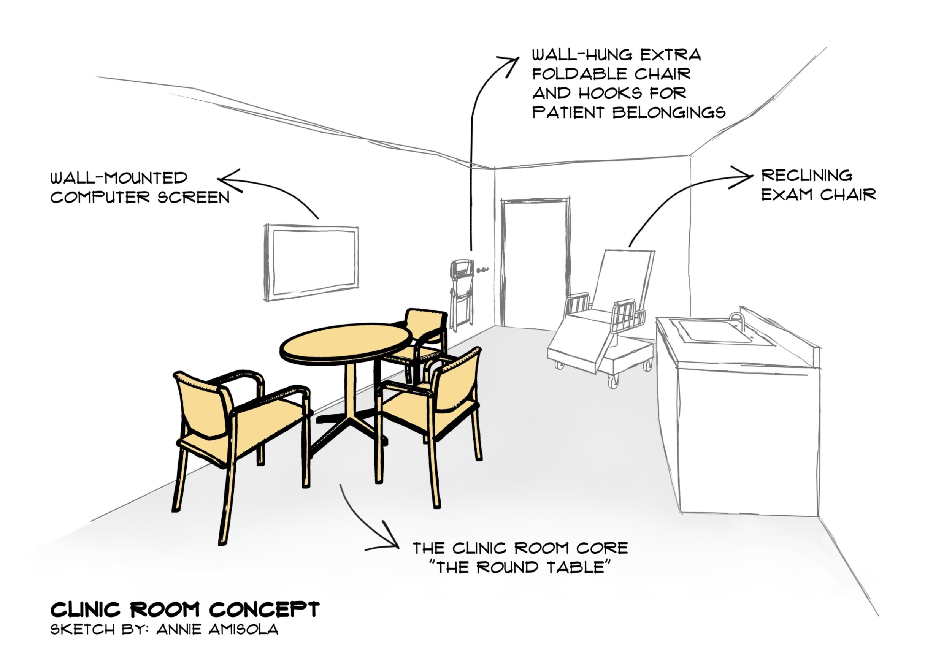
Designing for Shared Decision Making
Notes:
Design means more than what can be drawn or built. The building must also consider in the design the clinical processes and models of care.
Design of clinical processes.
Pendulum to rest in middle so design is mutually beneficial for both patients and staff and families: the round table, design equity.

Slide 29
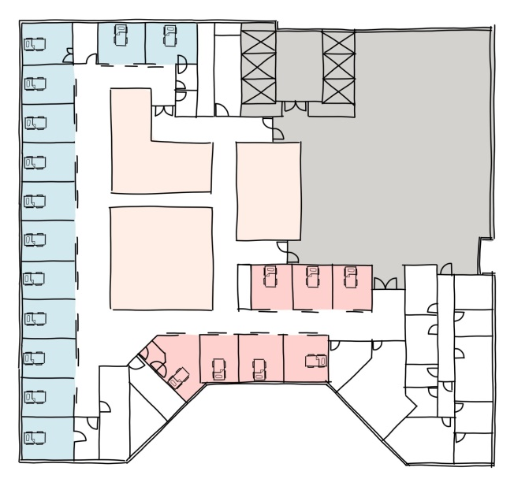
ICU Delirium and Windows
Table 2: Association of Windowed ICU Room with the Presence of a Positive CAM
 | Odds Ratio (95% CI) | P Value
Windowed Room, Unadjusted* | 1.40 (1.17 to 1.69) | <0.001
Windowed Room, Adjusted⁺ | 1.33 (1.10 to 1.62) | 0.004
CAM = Confusion Assessment Method, ICU = intensive care unit, CI = confidence interval ⁺Adjusted for: year, age, sex, language preference, delirium home drug classes, delirium diagnosis, sensory impairment, and SOFA (Sequential Organ Failure Assessment) score.
Windowless patient rooms
Pilot Data. MGB Health Design Lab. Funding Source: MGB

Slide 30
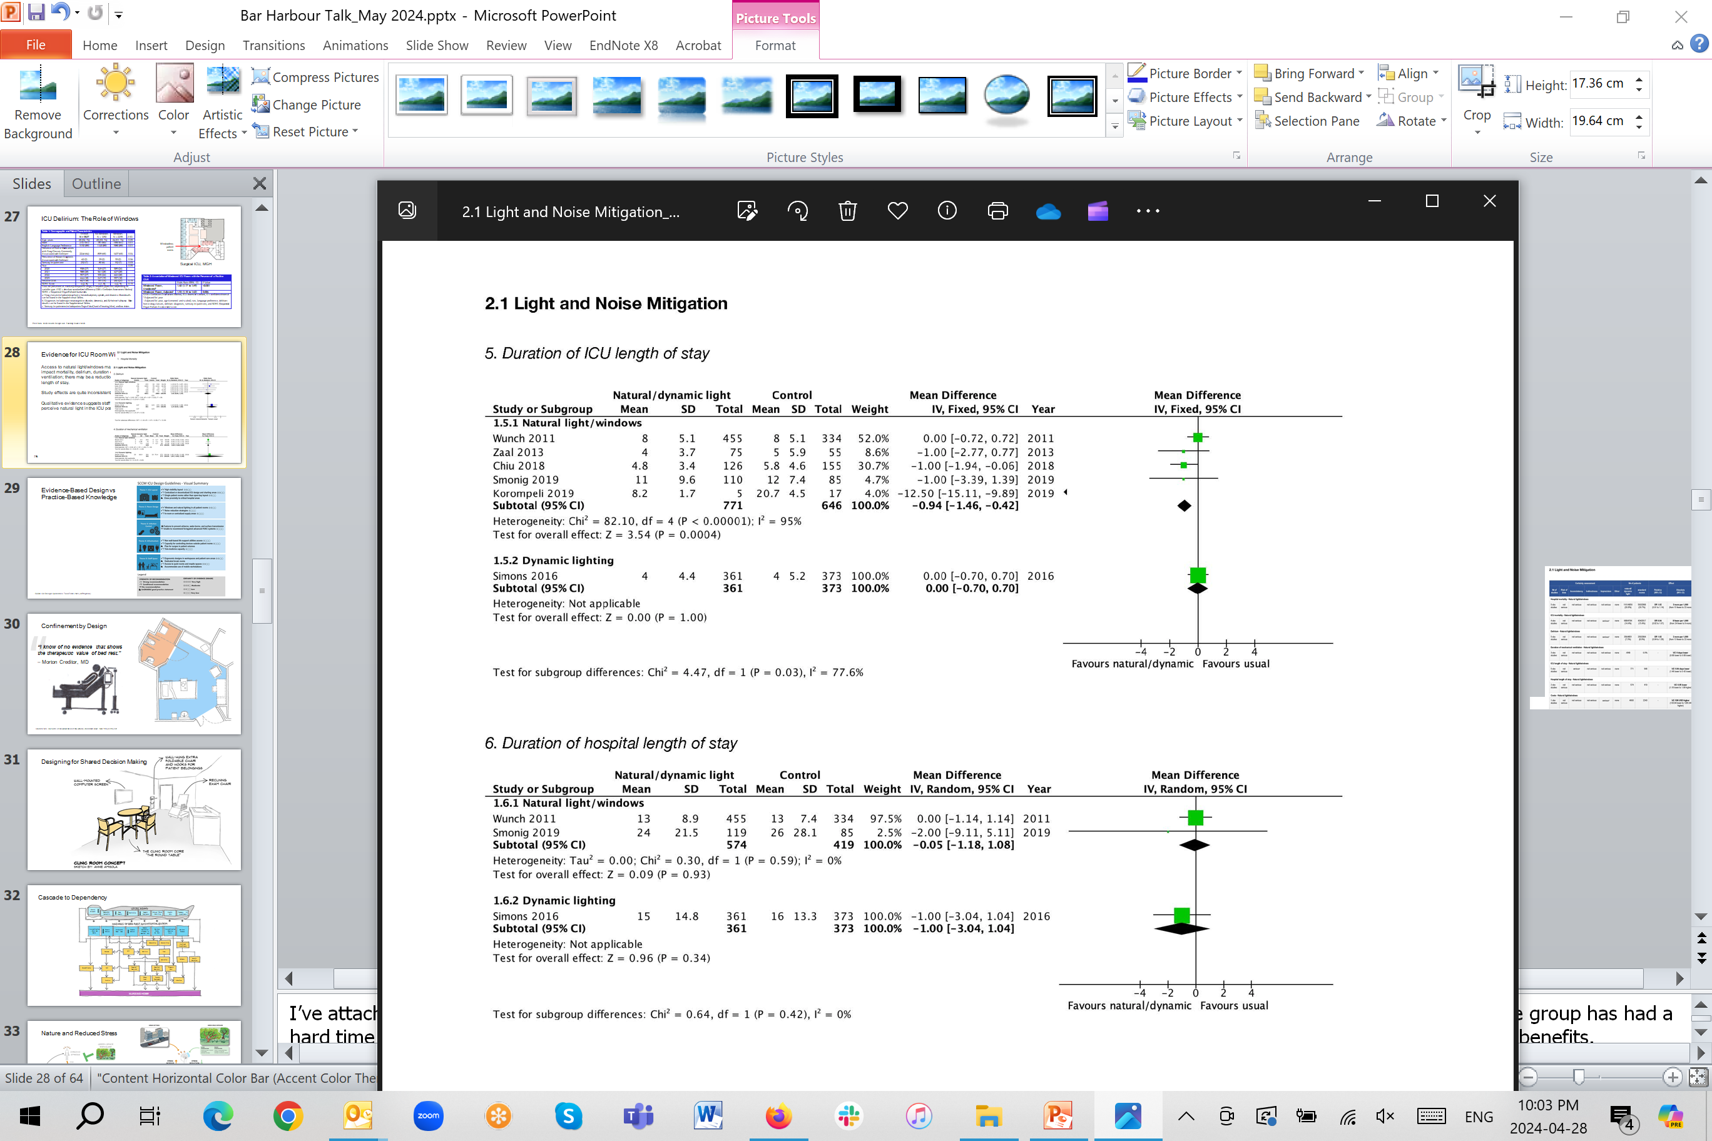
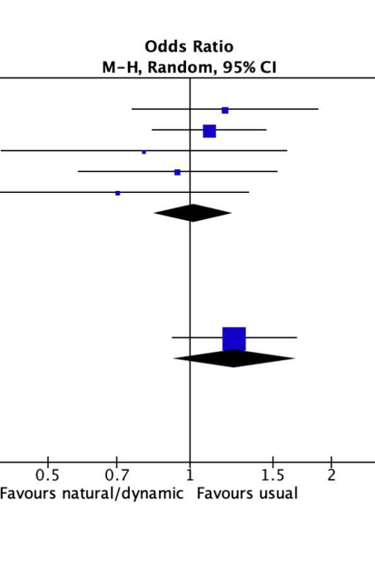
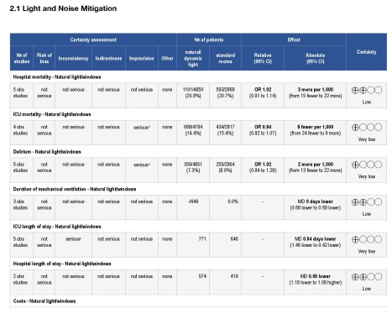
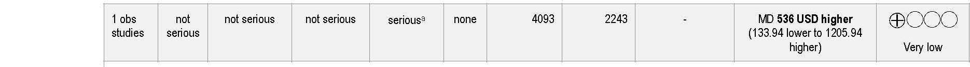
Evidence for ICU Room Windows
Access to natural light/windows may not impact mortality, delirium, duration of ventilation; there may be a reduction in length of stay.
Study effects are quite inconsistent.
Qualitative evidence suggests staff perceive natural light in the ICU positively.
Delirium
ICU LoS
Hospital LoS
SCCM ICU Design Guidelines. Task Force 2024 (In Progress).
Notes:
I’ve attached here the evidence summary. You all might find the forest plots and odds ratios of interest as a quick way to see the data. The group has had a hard time making a firm recommendation for windows based on poor evidence, despite the fact that intuitively we all know windows have benefits.
In the delirium forest plot the Kohn 2013 study listed I know well and they looked at over 6,000 patients concluding that windows made no difference essentially, but we discussed last night in our design guidelines committee that 10 years ago sedation practices were different from today, as was our understanding and measurement of delirium.

Slide 31
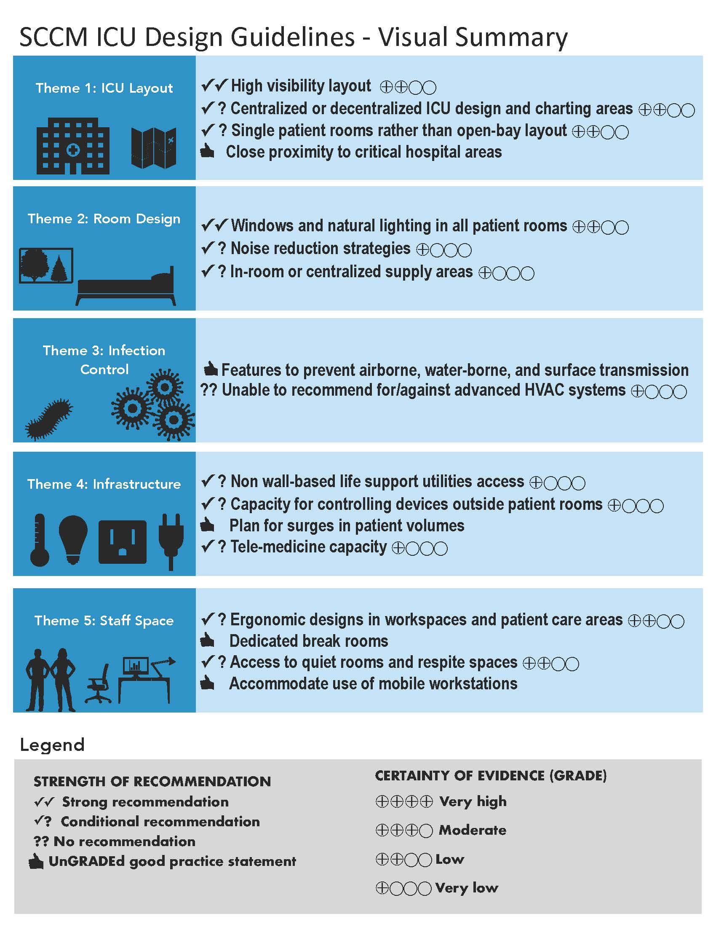
Evidence-Based Design vs Practice-Based Knowledge
SCCM ICU Design Guidelines. Task Force 2024 (In Progress).

Slide 32
Long Term Care Design
Notes:
EBD is primarily focused on patient outcomes, and began that way. Everywhere you see the headlines “putting patients first”, “transforming the patient experience”. But whose voice should be prioritised when funding and designing hospitals and health services? In other words, who are we designing hospitals for­­- the clinicians, the patients and their families, the administrators?
By “our” I don’t mean only the architects but also the policy makers, administrators etc

Slide 33
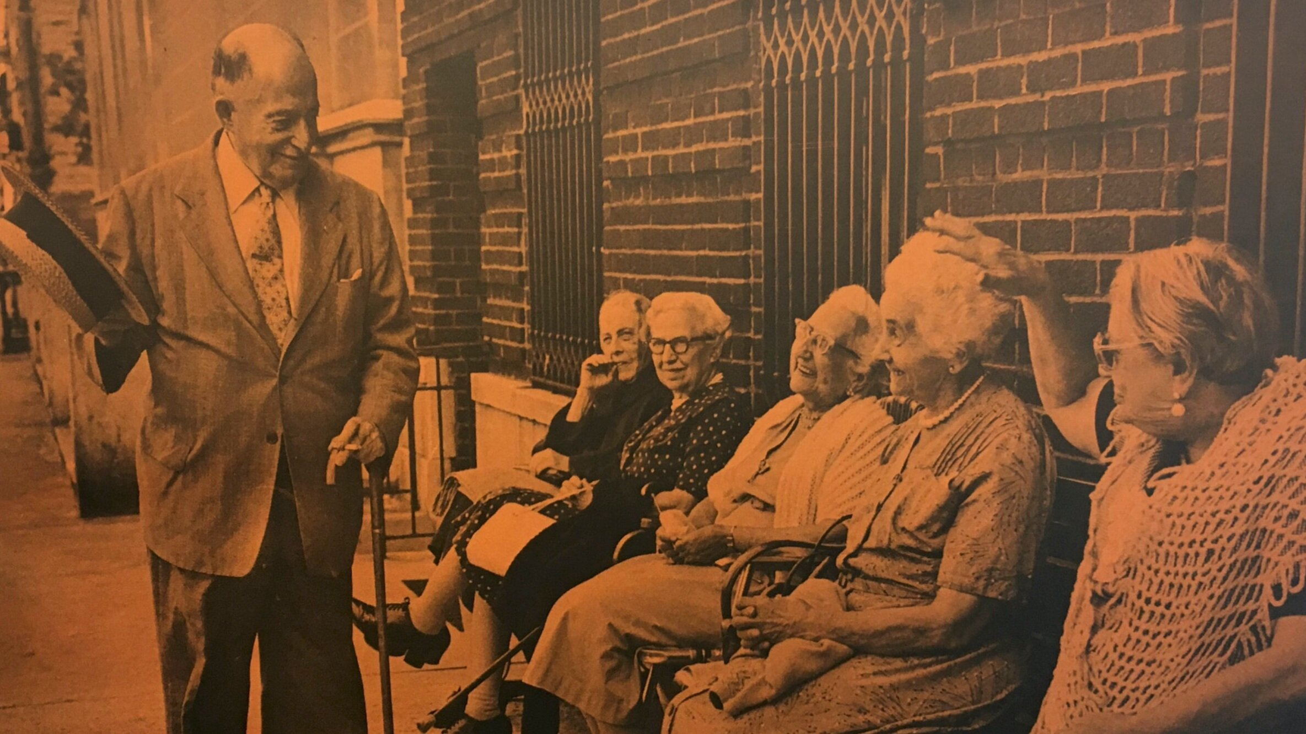

“Even in old age… there is joy, companionship, and spontaneity which…is facilitated by the material context—the places and porches—that
allow the elderly to touch the world beyond.”
Reference: Platform: https://www.platformspace.net/home/viewing-watching-observing-aging-and-the-architecture-of-intermediate-space
Notes:
street ballet, to invoke Jane Jacobs

Slide 34
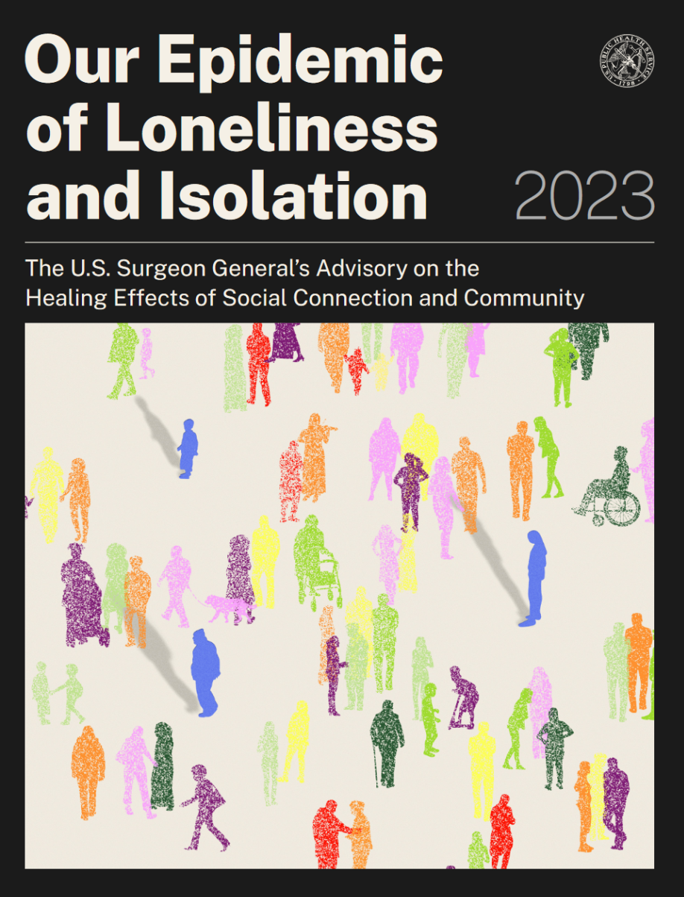
Design the built environment to
promote social connection…
Our Epidemic of Loneliness and Isolation: The U.S. Surgeon General’s Advisory on the Healing Effects of Social Connection and Community. 2023. https://www.hhs.gov/sites/default/files/surgeon-general-social-connection-advisory.pdf
Notes:
Many factors that influence social connection are environmental. Decisions about the layout of our cities, from the usability and reach of public transportation to the
design of housing and green spaces, have a direct effect on social interaction in a community

Slide 35
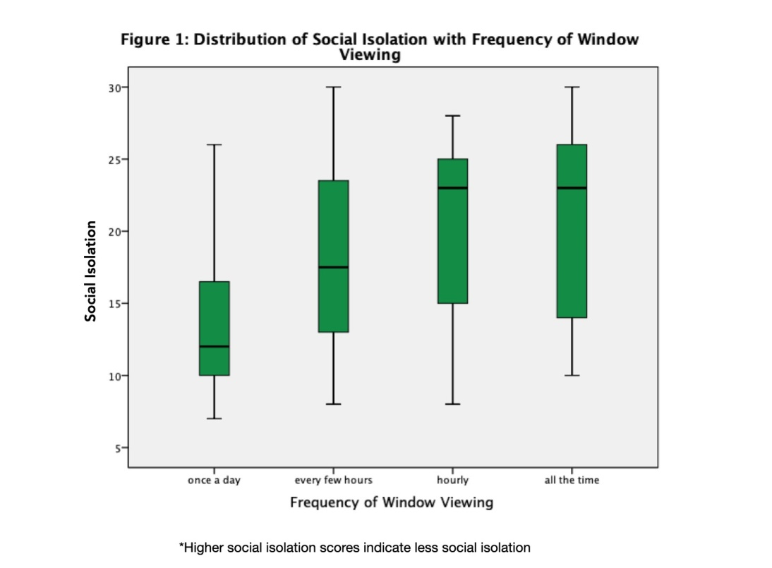
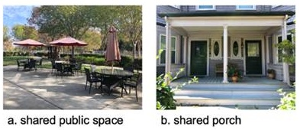
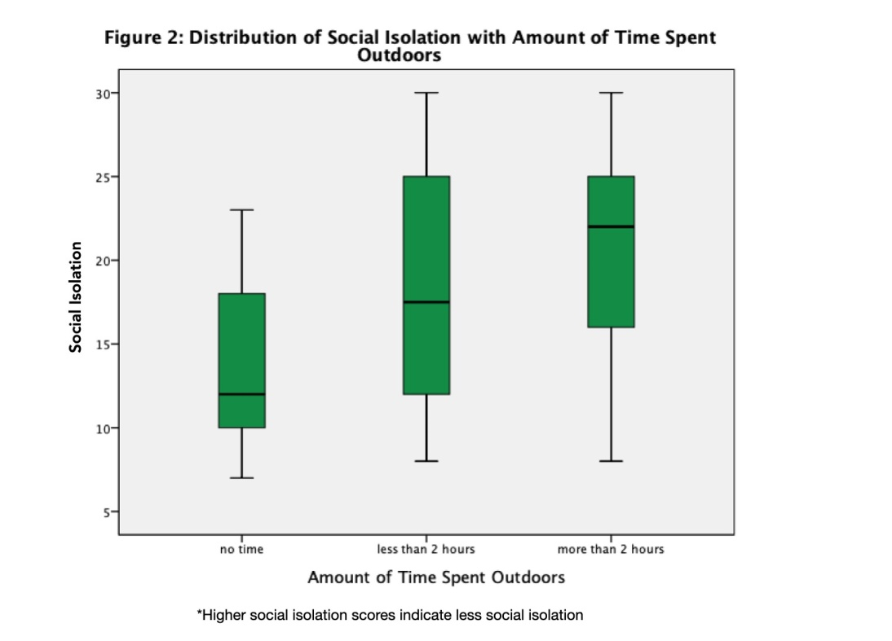
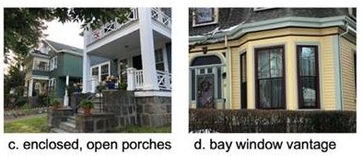
AACSF Transitional Spaces
Individuals who frequently looked out the window experience significantly less social isolation.
r(67)= .266, p= .030
Individuals who spent more than 2 hours in outdoor space experienced significantly less social isolation.
F(2,73)= 3.40, p=.039
80 older adults with and without ADRD, ages 50 to 90 (M = 73.9, SD = 7.8)
This work was supported by the Boston University Alzheimer’s Disease Research Center (P30-AG072978), the U.S. Department of Veterans Affairs (VA) Merit Award (CX001698), a VA Merit Award (CX002400-01A2), a VA Career Development Award (CX002065), and by grants from the Alzheimer’s Association (AACSF-22-923724 and AACF-16-443347).
Notes:
Marginal difference between no time + more than 2 hours Mdiff =6.32, SE=2.58, p=.050 95% CI [.0011, 12.64]

Slide 36
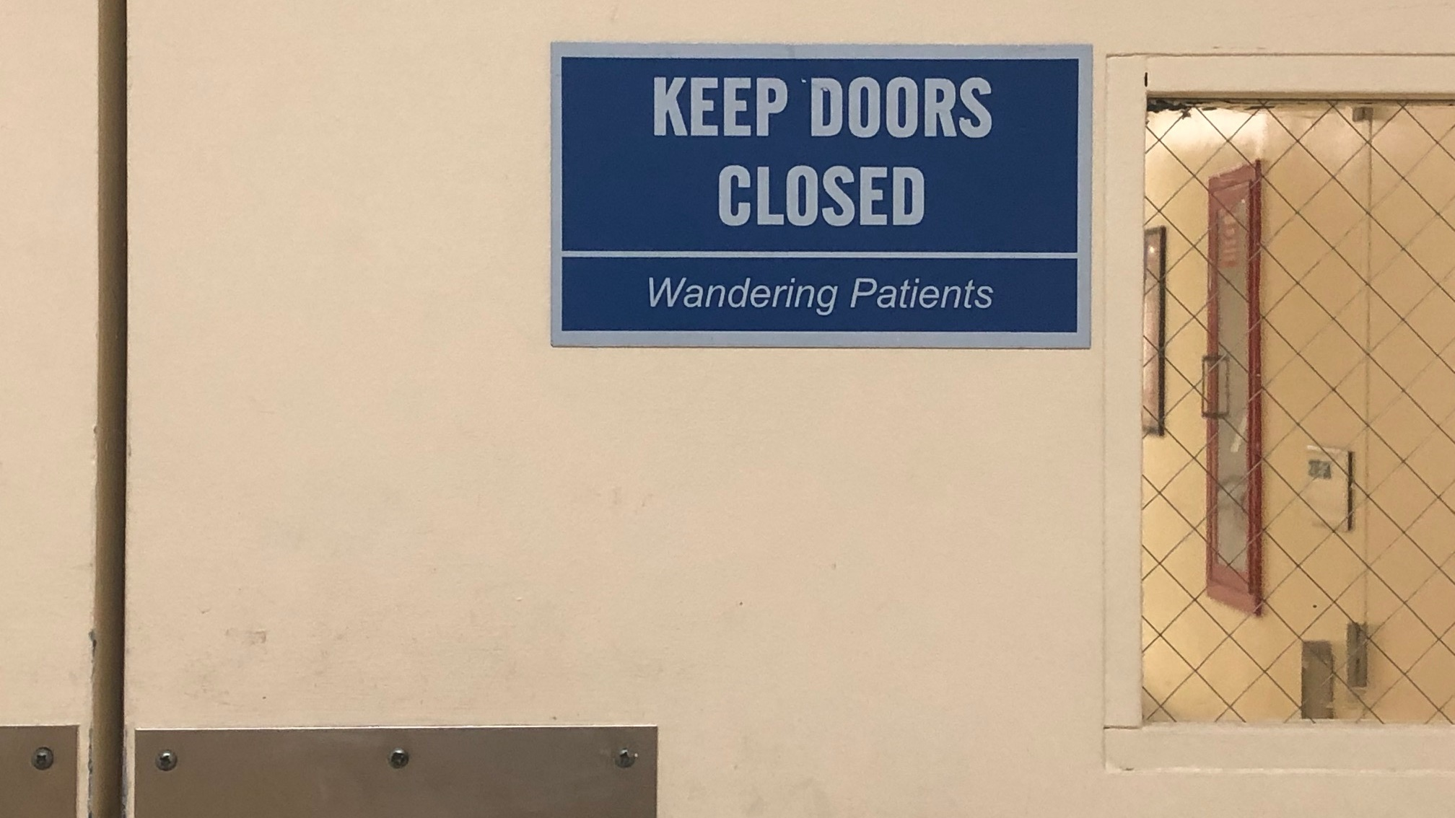
Photo Credit: Diana Anderson

Slide 37
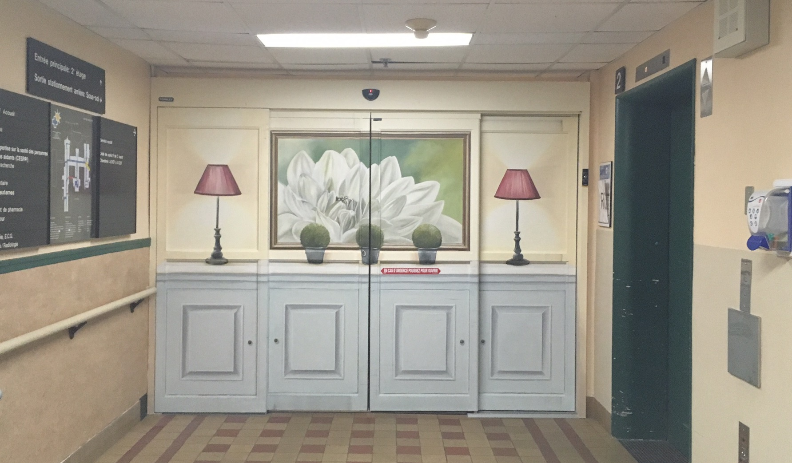
Photo Credit: Diana Anderson

Slide 38
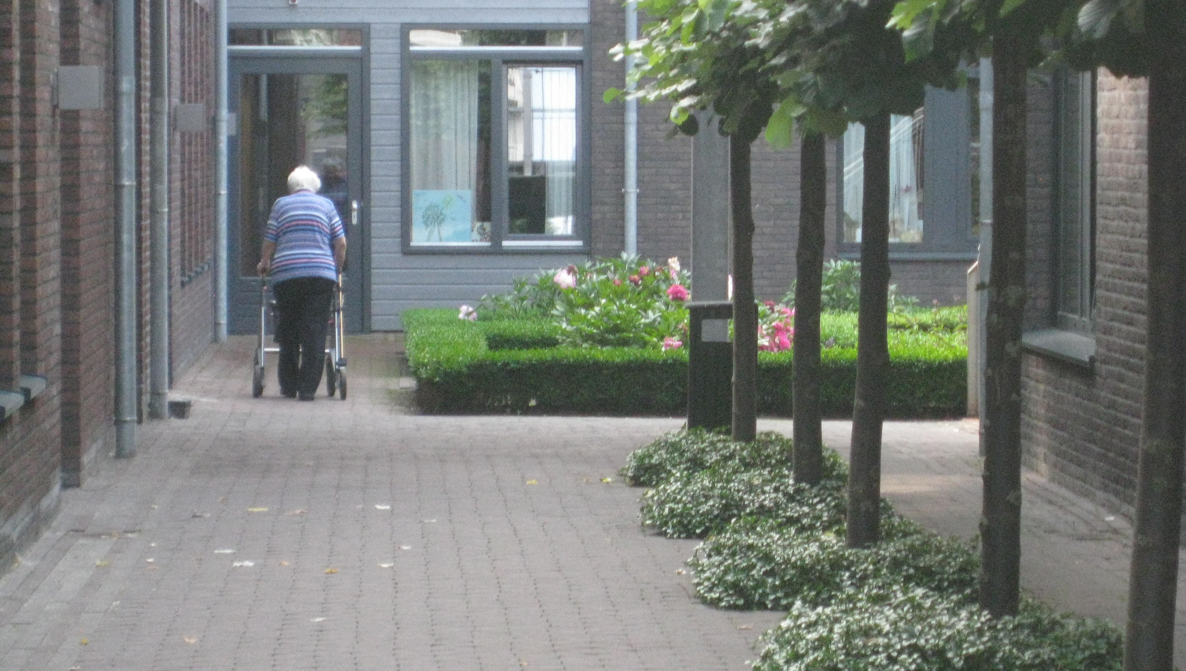
De Hogeweyk, Dementia Village
Weesp, The Netherlands
Molenaar & Bol & VanDillen

Slide 39



Project: De Hogeweyk, Dementia Village, Weesp, The Netherlands; Molenaar & Bol & VanDillen
Notes:
Diana

Slide 40
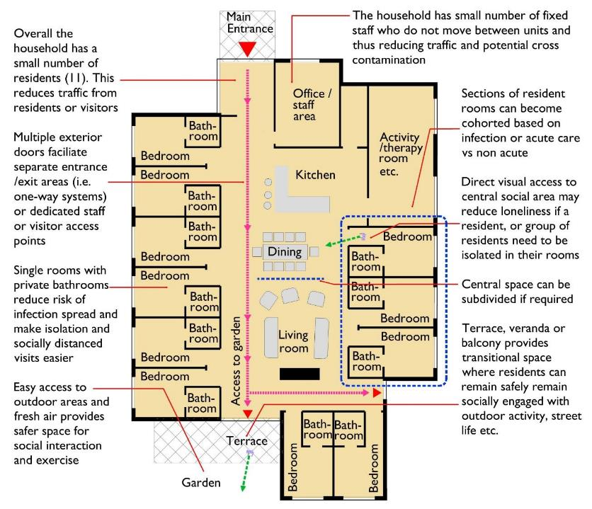
Design Matters in LTC
Household model: 10-12 single rooms with private bathrooms
Central communal area
Access to protected outdoor space
NURSING HOME
Anderson DC, Grey T, Kennelly S, O'Neill D. Nursing Home Design and COVID-19: Balancing Infection Control, Quality of Life, and Resilience. J Am Med Dir Assoc. 2020;21(11):1519-1524.

Slide 41
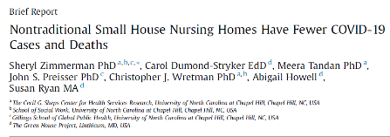
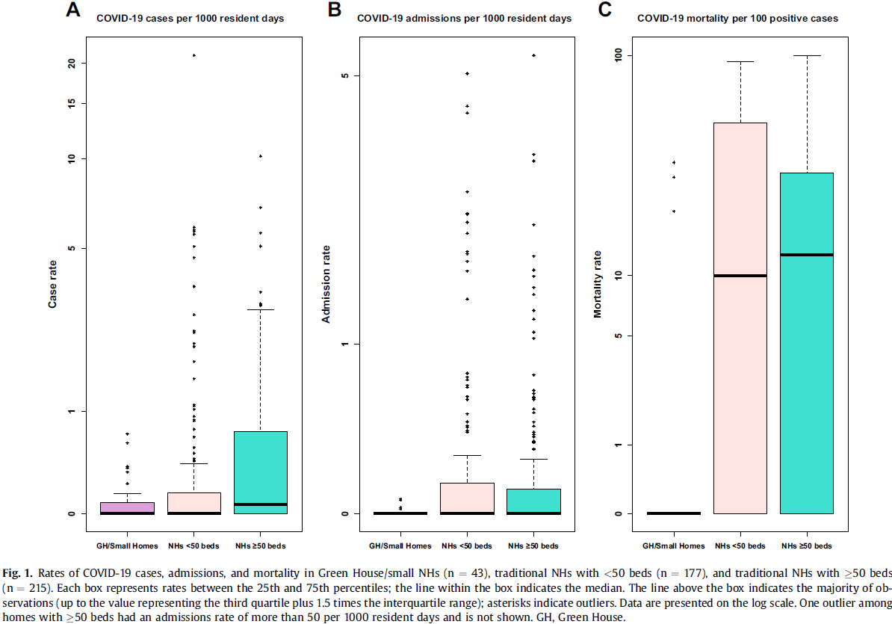
Small Houses & COVID Deaths
Zimmerman S, Dumond-Stryker C, Tandan M, et al. Nontraditional Small House Nursing Homes Have Fewer COVID-19 Cases and Deaths. J Am Med Dir Assoc. 2021;22(3):489-493. doi:10.1016/j.jamda.2021.01.069cc

Slide 42
Small House Model - Benefits
Non-traditional “green house” homes (10-12 residents) - benefits
Improved resident quality of life, fewer hospital readmissions, better quality indicators, reduced Medicare spending, possibly less staff turnover
Improved infection control
COVID-19 incidence and mortality rates are less in green house/small nursing homes versus traditional nursing home models with <50 beds and ≥50 beds
Not necessarily higher costs
Overall, fixed costs of small-home models may be higher but operational costs are similar; more direct-care and nursing time in small-homes with potential revenue enhancements
Zimmerman S, Bowers BJ, Cohen LW, et al. THRIVE Research Collaborative. New evidence on the Green House Model of nursing home care: synthesis of findings and implications for policy, practice, and research. Health Serv Res 2016; 51(Suppl 1):475e496.
Zimmerman S, Dumond-Stryker C, Tandan M, et al. Nontraditional Small House Nursing Homes Have Fewer COVID-19 Cases and. J Am Med Dir Assoc. 2021;S1525-8610(21)00120-1. Jenkens R, Sult T, Lessell N, Hammer D, Ortigara A. Financial Implications of THE GREEN HOUSE® Model. Seniors Housing & Care Journal. 2011; 19(1): 3-22.
Notes:
$1,300 to $2,300 less in total Medicare and Medicaid costs per resident over 12 months for residents in Green House vs. traditional nursing homes

Slide 43

Emerging Ethical Issues in LTC Design
The Need for Empiricism
LTC facility design is being increasingly used to modify behavior and create illusions that pacify residents, without research or oversight.
Design interventions may include:
The illusion that one is free to leave;
Immersive environments that convince people they are somewhere else;
Controlling behavior with designs that induce immobility or evoke fear.
These efforts are no different in kind than interventions undertaken in medical research or pharmaceutical development.
Image by: Tom Grey, Trinity Haus, Dublin

Slide 44

Notes:
It is time for the built environment to become a part of the same calculus as other physical and psychological factors affecting care.
Funding and scholarly research is required to investigate the curative efficacies of specific architectural interventions.
The ethical issues in healthcare architecture experimentation requires an ethical rubric to clarify the intent, risks, and expected outcomes.
Healthcare architects need to engage with policy and public health leaders around issues of equal access and treatment, prevention of comorbidities, and use of space to influence people.
Architecture and design provides opportunities to create lasting improvements in equitable, efficient care delivery and preparedness for the next public health emergency.

Slide 45
Thank You!
Diana Anderson, MD, M.Arch, FACHA
Assistant Professor of Neurology, Boston University
Co-Founder, MGB Health Design Lab
Healthcare Principal, Jacobs
@dochitect www.dochitect.com diana.anderson@dochitect.com

Slide 46
Fireside Chat

Slide 47


Health Architecture is a Public Health Issue
Virtual Technology
Placemaking and the Role of the Arts
Health in the City
Who should fund and conduct the evidence-based research / functional performance?
People in the City
1- Standardization of stakeholder feedback
2- Design frameworks to ensure inclusivity
3- Funding and conducting research / functional performance
Wellness

Slide 48
How can we standardize the process of stakeholder feedback?
Notes:
EBD is primarily focused on patient outcomes, and began that way. Everywhere you see the headlines “putting patients first”, “transforming the patient experience”. But whose voice should be prioritised when funding and designing hospitals and health services? In other words, who are we designing hospitals for­­- the clinicians, the patients and their families, the administrators?
By “our” I don’t mean only the architects but also the policy makers, administrators etc
Stakeholder engagement /design equity, and inclusivity User feedback - Clinician and not Clinician Peer review and post occupancy Evidence integration
Who what when where why?
How to integrate these into design process.
Who should do it? Should there be a national level thing or individual firms
When should this occur in the design process. On multiple points or just at the start or at the end
Discussion of design versus standardization with subthemes. And questions. Use shari graphic printed? Cards and markers?
Fireside session
Ask questions and brainstorm answers? Ie: who should do this research, funding, etc
Print stuff and have cards and markers
Design equity – stakeholder engagement
5Ms? Framework
POE
“Who should decide whether and how stakeholders’ needs are met?”
can be answered in the same way we make other decisions in healthcare that involve technical expertise and normative concerns: shared decision-making.
Shared decision-making allows for a role delineation for healthcare providers and patients or their families; providers are responsible for determining the range of appropriate options based on the best available evidence. When that is lacking, providers rely on clinical judgment borne out of long practice.

Slide 49

Design Intent
User Experience
Notes:
Can architecture have the power to support caregivers’ ability to heal and delivery of care? There is often a gap between design intent and user experience. The classic urban planning example of this is seen with campus planning.

Slide 50
Stakeholder
Inclusivity
Technically, Logistically, & Financially Possible Options
Range of possible options
Evidence-Based Preferences
Options reduced by evidence
Value Preferences
> 1 evidence-based option exists, benefits are in equipoise or unknown: stakeholders voice
Successful decision-making involving the available range of options, evaluated by evidence, and a consensus approach with stakeholders affected by the decision.
Balanced Stakeholder Representation
Anderson D, Teti S. Shared Decision-Making in Healthcare Facility Design. AMA Journal of Ethics. 2024 (Accepted for Publication).
Notes:
Range of technically possible options
Wide options reduced by evidence-based performance assessment; where is the most benefit accrued?
Where more than one evidence-based options exists, or benefits are in equipoise (or unknown), stakeholders affected should have a voice

Slide 51
Application of design frameworks to ensure inclusivity (e.g.: 5Ms)?
Notes:
EBD is primarily focused on patient outcomes, and began that way. Everywhere you see the headlines “putting patients first”, “transforming the patient experience”. But whose voice should be prioritised when funding and designing hospitals and health services? In other words, who are we designing hospitals for­­- the clinicians, the patients and their families, the administrators?
By “our” I don’t mean only the architects but also the policy makers, administrators etc
Stakeholder engagement /design equity, and inclusivity User feedback - Clinician and not Clinician Peer review and post occupancy Evidence integration
Who what when where why?
How to integrate these into design process.
Who should do it? Should there be a national level thing or individual firms
When should this occur in the design process. On multiple points or just at the start or at the end
Discussion of design versus standardization with subthemes. And questions. Use shari graphic printed? Cards and markers?
Fireside session
Ask questions and brainstorm answers? Ie: who should do this research, funding, etc
Print stuff and have cards and markers
Design equity – stakeholder engagement
5Ms? Framework
POE
“Who should decide whether and how stakeholders’ needs are met?”
can be answered in the same way we make other decisions in healthcare that involve technical expertise and normative concerns: shared decision-making.
Shared decision-making allows for a role delineation for healthcare providers and patients or their families; providers are responsible for determining the range of appropriate options based on the best available evidence. When that is lacking, providers rely on clinical judgment borne out of long practice.

Slide 52
















5Ms for Design?
Mobility
- Community Context -
Matters
Most
Mind
Matters
Most
Mind
Hospital / LTC
Medication
Medication
Multi-complexity
Multi-complexity
Reference: http://www.ihi.org/Engage/Initiatives/Age-Friendly-Health-Systems/Pages/default.aspx
Notes:
Set of 5 evidence-based elements of high quality care
When implemented together shifts focus towards user needs
Inclusive of complex biopsychosocial situations
Application across spatial scales:
patients & caregivers
healthcare buildings
urban fabric & community

Slide 53
Mind
Reference: Platform: https://www.platformspace.net/home/viewing-watching-observing-aging-and-the-architecture-of-intermediate-space
Notes:
street ballet, to invoke Jane Jacobs

Slide 54

Medications
Photo credit: Diana Anderson

Slide 55

Mobility
De Hogeweyk, Dementia Village
Weesp, The Netherlands
Molenaar & Bol & VanDillen

Slide 56

Multicomplexity

Slide 57

Matters Most
Graphic: Thomas Grey, Trinity College, Dublin

Slide 58
How to advance evidence-based research / functional performance assessments?
Notes:
EBD is primarily focused on patient outcomes, and began that way. Everywhere you see the headlines “putting patients first”, “transforming the patient experience”. But whose voice should be prioritised when funding and designing hospitals and health services? In other words, who are we designing hospitals for­­- the clinicians, the patients and their families, the administrators?
By “our” I don’t mean only the architects but also the policy makers, administrators etc
Stakeholder engagement /design equity, and inclusivity User feedback - Clinician and not Clinician Peer review and post occupancy Evidence integration
Who what when where why?
How to integrate these into design process.
Who should do it? Should there be a national level thing or individual firms
When should this occur in the design process. On multiple points or just at the start or at the end
Discussion of design versus standardization with subthemes. And questions. Use shari graphic printed? Cards and markers?
Fireside session
Ask questions and brainstorm answers? Ie: who should do this research, funding, etc
Print stuff and have cards and markers
Design equity – stakeholder engagement
5Ms? Framework
POE
“Who should decide whether and how stakeholders’ needs are met?”
can be answered in the same way we make other decisions in healthcare that involve technical expertise and normative concerns: shared decision-making.
Shared decision-making allows for a role delineation for healthcare providers and patients or their families; providers are responsible for determining the range of appropriate options based on the best available evidence. When that is lacking, providers rely on clinical judgment borne out of long practice.

Slide 59



Building Performance
Age
Resilience (seismic)
Fabric & Service Condition
Building Physical Rating
Optimal Good Satisfactory Limited Poor

Slide 60


Rating Matrix
Building Physical Rating
Building Functional Rating
Departmental Functional Rating
  Retain
  Buildings that achieve a high score in physical and functional performance.
  Refurbish
  Buildings that achieve a physical performance of under 50% but achieve a great functional performance
  Repurpose
  Buildings that achieve a low functional score but are physically performing well
  Review
  Low score in both functionality and physical performance.

Slide 61






Combined Assessment Maps
Regional Ratings by Department
Building Physical Rating
+
Departmental Functional Rating
Geographical info by assessed site
+/-
Demographic overlay
Notes:
Geographical info by assessed site
Demographic Overlay

Slide 62

Discussion

